Slide 1
Registered Apprenticeship
Adult and Youth Opportunities
Joint AAE/WIOA Youth Conference
October 1, 2019
Presenter: Anne Velardi

Slide 2





What is Registered Apprenticeship?
Employer Involvement
Structured
On-the-Job Learning
Related Technical Instruction
Rewards for Skill Gains
National Occupational Credential
Five Core Components of
Registered Apprenticeship
Registered with the U.S. Department of Labor, Office of Apprenticeship and/or Federally Recognized State Apprenticeship Agencies
Notes:
Related Technical Instructions- Can come from an online program, college or employer in house training program that will give the employee national recognition.
No apprenticeship without a job!
Doesn’t have to mean union

Slide 3
Benefits
Employers
Employees
Skilled employees tailored to employer’s needs
Program approved for WIOA Eligible Training Provider List
Payroll and training cost savings
A systematic approach to training
Reduced turnover rates
Lower recruitment costs
A pipeline of skilled workers
A Career
A Paycheck-average apprentice wage = $60K/year
An Education
Possible college credit
Hands-on Career Training
National Certification

Slide 4
Apprentice Minimum Requirements
Minimum Age of 16 Years Old
U.S. Citizenship, Permanent Residency Status or Residents Whose Visas Permit Employment Within the United States
Ability to Satisfy Sponsor Additional Minimum Requirements (if applicable) (Education, Physical Ability, Background Checks, Drug Testing, etc.)
Ability to Successfully Complete OJL and RTI Requirements (Assessed by Sponsor)
Desire to Earn – Learn – Succeed!

Slide 5

Health Care Apprenticeship in Alaska
Apprenticeable Health Care Occupations in Alaska
Behavioral Health Aide
Dental Assistant
MRI Technologist
Dispensing Optician
Medical Office Assistant
Medical Assistants
Nurse Assistants
Chiropractic Clinical Assistant
Pharmacy Tech
Sterile Processing Tech
Surgical Technologist
Tumor Registrar
Medical Biller-Coder
Notes:
Due to the extensive shortage in the Health care industry we are placing more focus on this industry to try to meet the demands of the aging population.

Slide 6
Construction/Transportation/Hospitality
Electrician
Plumber
Pipefitter
Boilermaker
Welder
Carpenters
Sheet Metal Workers
Millwrights
Ironworkers
Operating Engineers
Pile drivers & Divers
Merchant Marines
Construction Drivers
Truck/Bus Mechanics
Automotive Mechanics
Machinist
Building Maintenance
Cook
Food Service Manager
Meat Cutter
Notes:
There are many more.

Slide 7
How do you become an apprentice?
Apply to an established apprenticeship program-e.g.-IBEW, ABC, Teamsters, etc.
Get employed with an individual sponsor of apprenticeship
Get a job and talk to your employer about apprenticeship-DOLWD will market the apprenticeship if there is interest
Participate in a pre-apprenticeship program or School-to-Apprenticeship program

Slide 8
Quality Pre-Apprenticeship for Youth
A pre-apprenticeship is a program designed to prepare individuals to enter and succeed in a RA program. Pre-apprenticeship programs should have strong direct linkages with RA.
Students take courses for the purpose of their pre-apprenticeship that are approved by a RA program in addition to their required high school coursework. These courses count towards high school graduation.
Students participate in OJL activities beginning at age 16, which can count towards entry into an RA program. As students move through the program, they advance their OJL to become more skilled and more productive.
Students may have opportunities to earn industry-recognized credentials and certifications.
Students can apply to the RA program leading up to or upon high school graduation.
Postsecondary credits are awarded based on signed articulation agreements established between local school districts, postsecondary institutions, and RA programs.

Slide 9
School to Apprenticeship
High school students enrolled in secondary school who meet the minimum legal age of 16 can be employed as apprentices
Must comply with all applicable state and federal labor laws
Programs for high school students should combine academic and technical classroom instruction with work experience, allowing youth to explore a career and develop industry- specific workplace competencies, skills and knowledge, while still enrolled in high school.
Programs should align academic and technical standards in secondary and postsecondary education, CTE, and industry-recognized credentials and certifications.
Programs should incorporate stackable credentials of value for multiple pathways, including entrance into RA programs, community and technical colleges, universities, and sustainable employment.
Students may have opportunities to earn industry-recognized credentials and certifications.

Slide 10
Partnerships
Schools and other institutions can partner with DOLWD, sponsors, and other relevant groups to create pre-apprenticeship and Registered Apprenticeship opportunities for youth.
Grants may be available to help create these opportunities.
Good partnerships will meet the needs of all interested parties.

Slide 11
Grants
Apprenticeship grants-AAI, SAE, ASE
IWT
IWT-Opioids
WIOA-DLW, STEP

Slide 12


Department of Labor & Workforce Development
Division of Employment and Training Services
Statewide Apprenticeship Coordinator
anne.velardi@alaska.gov
(907) 269-3729/(907) 269-3562
Program Coordinator II - Grant Manager
julie.frizzell@alaska.gov
(907) 269-4590

Slide 13
Pathways to Registered Apprenticeship
Alaska Works Partnership- Construction Academy, Women-in-the-Trades, Helmets to Hardhats, Apprenticeship Outreach, Pre-Apprenticeship
PATH Academy-Pre-Apprenticeship, basic healthcare training, certifications, job search skills, connection to employment

Slide 14

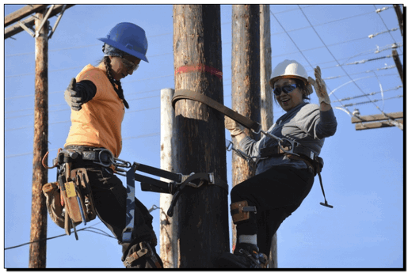

Slide 15
Mission: INCREASE ALASKA HIRE IN CONSTRUCTION INDUSTRY
Non-profit organization that was created in 1996.
Give Alaskans access to jobs and careers in the construction industry by providing construction training and education.
Educate adults and youth in our community about apprenticeship and the good paying jobs in construction.
Teach the basic skills individuals need to better their chances of becoming employed.
Funded by the Alaska Department of Labor & Workforce Development.
Training offered in Anchorage, Mat-Su, and Fairbanks
Programs:
Alaska Construction Academy (Co-ed training, anyone)
Women In the Trades (For Women, STEP eligibility required)
Rural Apprenticeship Outreach
Helmets to Hardhats (For Military and spouses)

Slide 16

Benefits of our program
Completing our courses helps people gain job skills that make them more employable for construction careers and better candidates for apprenticeship
Upon completing a core class with Alaska Works Partnership, trainees will earn a certificate of instruction.
We also provide resource packets to our students with current job searching information and apprenticeship openings.
If students go on to apply with any apprenticeship program or any construction related job, Alaska Works Partnership offers trade-specific Interview Skills classes and application assistance.
Our case managers assist students in any way they can with pursuing a career in construction.
Networking with our numerous partners.

Slide 17
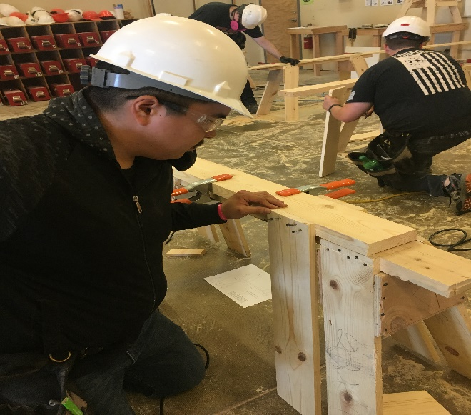
Our trainings are…
Short-term: Most of our classes are 40 hours, held Monday-Friday during the day from 8am-5pm. We also offer Welding classes during weekday evenings and Saturdays.
Introductory and Hands-on: No experience necessary to take our classes, we offer basic skills training.
Free: No cost to participants.
Competitive at times: People need to apply online and submit required documents. We interview all eligible applicants then select students and place them into class. Sometimes we receive more applicants than spots so not all applicants are placed in a class.
High quality: Our trainings are instructed by experienced journeyman level professionals and above who have worked in the field in the specific trade they are instructing.

Slide 18
TRAINING Requirements
The ideal applicant should: like to work with their hands, enjoy being outdoors and being physically active, be able to work outside during winter months, be able to pass a drug test, and be okay with seasonal work and be able to budget appropriately.
An applicant’s first step is to apply online at www.alaskaworks.org, all training application links are available from our homepage.
Provide Photo ID and any other required documentation depending on which class they are applying for. The requirements are specified in an auto-response email all applicants will receive upon submitting their application.
These can be attached to an application or submitted later but applicants aren’t considered complete until they submit the required documents.
After the interview process, we try to make student selections at least two weeks prior to each training.
Work Keys testing may be required: these can be scheduled at a Job Center or Nine Star.

Slide 19

Alaska works Construction Academies
Anchorage, Mat-Su & Fairbanks
Co-ed: men and women are encouraged to apply
High School youth 16 and older can attend with guardian permission
Free, basic, introductory hands-on classes in a variety of trades depending on the community.

Slide 20
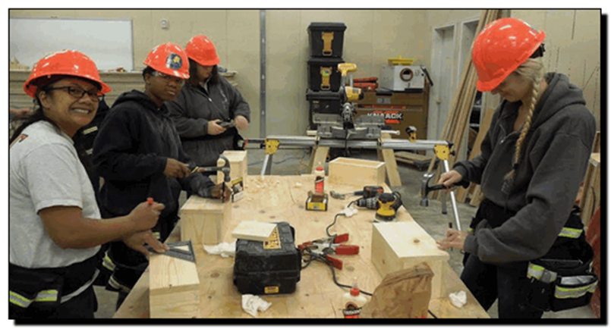
Women in the trades
Training program offered in a women-only training environment, with the intent to encourage and empower females to pursue a career in construction
This program is separate from the other academy programs, and has different requirements.
Women are a minority in the construction industry and we are helping to change that.
Women In the Trades (WIT) requirement: that the applicant is STEP eligible meaning they have paid into Alaska’s Unemployment Insurance program in the last 5 years from the date of application. This means that you must have received a payroll check from an employer and had Unemployment Insurance (UI) taxes withheld.

Slide 21

helmets to hardhats
AK Helmets to Hardhats is a program designed for active, veteran and transitioning military members.
The AK Helmets to Hardhats (H2H) program is different from the other Academy programs, and has different requirements.
H2H applicants must submit additional documents with their application in order to be considered.

Slide 22


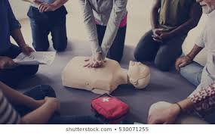
Health and safety courses
Once a student has successfully completed a core class with Alaska Works Partnership/Construction Academy, that applicant is now eligible to take any of our short health and safety courses.
These courses include a 2-year Medic First Aid/CPR/AED and a National OSHA 10 certificate that does not expire.
These courses are scheduled throughout the year, and are on a first come, first serve basis.
Only course completers are eligible and will receive this application link after completing any class we offer.

Slide 23
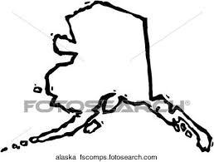
Rural Apprenticeship outreach
AWP provides rural community members with information on our training programs and apprenticeship information.
We have a lot of applicants and interest from people in rural Alaska villages and would like to serve them better.
We used to receive rural training and assistance funds but now have very limited assistance funds. Unfortunately, we do not receive funds to provide transportation, room or board for participants traveling from outside areas to our trainings.
We work with rural applicants and Native associations or tribal councils in order to help connect rural applicants to funding assistance so that they can attend our trainings.
We are always looking for partner opportunities to improve this process and meet the job development needs for more rural Alaskans.

Slide 24
AWP Pre-apprenticeship
In the coming months, AWP will have several construction trade Pre-Apprenticeships.
These will include 120 hours of instruction in Trade Prep, Trade Basics, and Trade Ready skills.
Individuals that successfully complete a Pre-Apprenticeship training will receive a Certificate of Completion.
This certificate will be recognized by Registered Apprenticeship partners and make qualifying completers eligible for direct-entry into their programs.

Slide 25
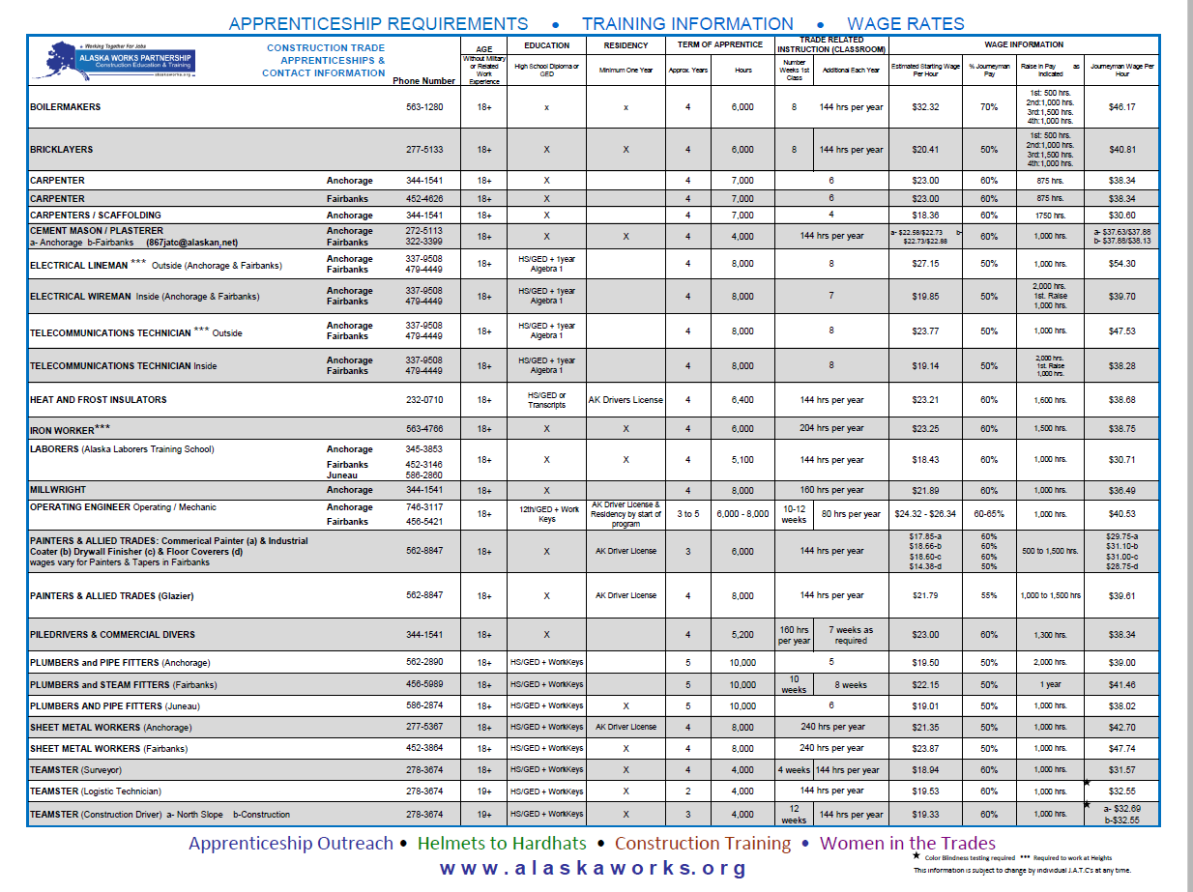

Alaska Apprenticeship information

Slide 26
Our partners
State of AK Job Centers/AKDOLWD
Nine Star Education and Employment Services
Alaska local JATC apprenticeship programs.
Several Native Associations and Tribal Councils
Mat-Su Borough and Anchorage School Districts
Various community organizations

Slide 27
Handouts available:
AWP’s general information, our programs and eligibility
Our Overall Training Schedule
AWP’s Class Descriptions
Construction Trade Descriptions
Apprenticeship Chart Information
Alaska Apprenticeship Application Openings & Deadlines
My business card

Slide 28
More INFORMATION
Alaska Works Partnership Training Center
161 Klevin Street (Main Office Suite 204)
(Bottom floor of Mountain View Service Center off of Mountain View Dr.)
We have two classrooms and a large shop space available for rent.
Main line (907)-569-4711
Website: www.alaskaworks.org

Slide 29


Our mission is to promote health workforce development so that all Alaskans have access to employment and quality healthcare.

Slide 30
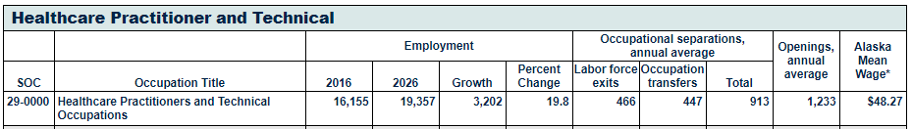
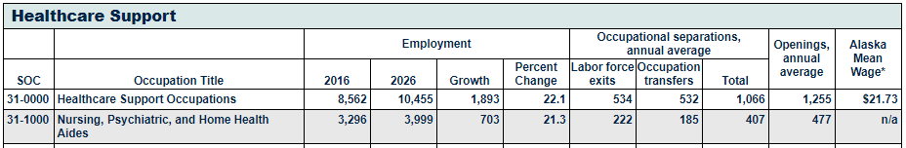
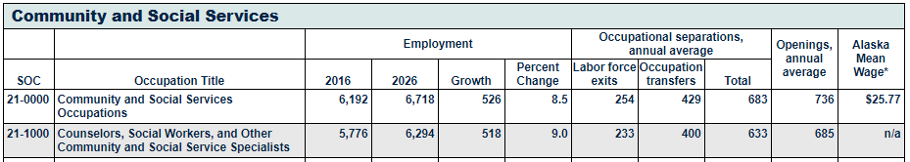
Alaska’s healthcare workforce deficit
Source: Alaska Occupational Forecast 2016 to 2026, Department of Labor and Workforce Development Research and Analysis
http://live.laborstats.alaska.gov/occfcst/

Slide 31

PATH Academy
Pre
Apprenticeship
Training in
Health Care
(and Behavioral Health and Human Services)

Slide 32
3- Week PATH Academy Instruction
Industry Credentials
BLS/CPR
Basic Knowledge
HIPAA
Soft Skills
Work Ethic and Performance
Work Readiness
Resumes
First Aid
Mental Health First Aid
Blood Borne Pathogens
The Mandt ® System
Medical Terminology
Medical Communication
Interviewing Skills
Job ShadowingPracticum Experience
Career Mapping
Caregiver Self-care
Cultural Safety/Competence
Networking
Teamwork and Relationships
Personal Image
Practicum Experience
Emotional Intelligence
Alaska Core Competencies
In-Training Interviews
Job Placement

Slide 33
Industry Recognized Credentials
  Mental Health First Aid Certification
  Bloodborne Pathogens Certification
  Basic Life Support CPR
  First Aid
  Alaska Core Competencies through Alaska Training Cooperative
  Certified Dementia Practitioner
  The Mandt System ®
Direct Support Professional (DSP) Jobs

Slide 34

How Do Participants Enroll?
Application on website www.scahecak.org
Phone interview with AHEC Staff
Onsite Orientation
Fingerprint Background Check
Drug Screening
Confirmation of enrollment

Slide 35

Our PATH Academy's Secret sauce
“Student Centered” training delivered with respect and love
Focused recruitment of unemployed or underemployed individuals
Concurrent recruitment of employers
Employment engagement activities built into the curriculum

Slide 36

Ideal Path Applicant
Desire to work and earn income right away
Own a car with a clean driving record
HS Graduate or GED
3 Training Weeks Away from being work ready
Must be 18

Slide 37
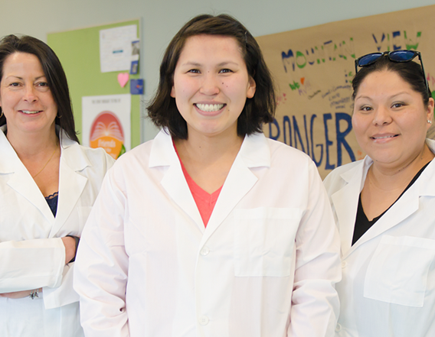
APCA Apprenticeships
Community Health Worker (CHW)
Certified Billing & Coding Specialist (CBCS)
Certified Clinical Medical Assistant (CCMA)
Certified Medical Administrative Assistant (CMAA)
Certified Electronic Health Record Specialist (CEHRS)
- Employed by Community Health Centers or another employer
- 140 hours of classroom training, 2000 hours working as an apprentice at a health facility

Slide 38

On the Horizon
PATH Academy adaptation for English Language Learners
  Collaboration with the Municipality of Anchorage, Alaska Literacy Program, and the Skilled Immigrant Integration Program (SIIP)
Partnership with APU
  With APU enrollment, can earn Undergraduate Certificate for completion of the Apprenticeship
  Pathway to Associates to Applied Science in Health Occupations
    With two additional semesters or so, completion of an AAS Degree
  Apprenticeship as a Recruitment Tool for Employers

Slide 39
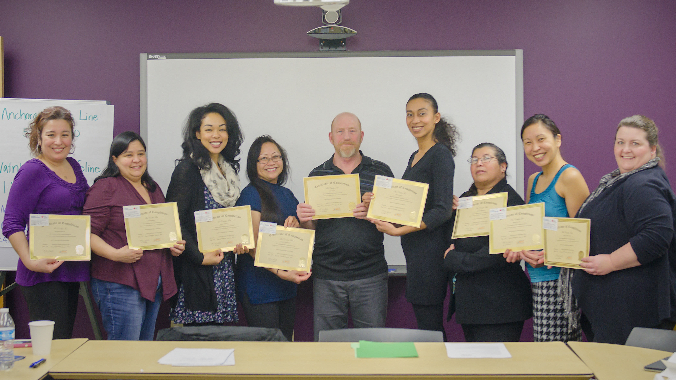
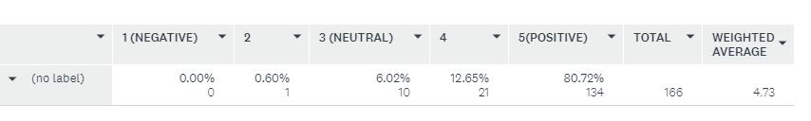
What our students say . . .
“I wanted to thank you from the bottom of my heart! This course was LIFE-CHANGING! I now have the courage to do and be who I am designed to be.”
Denise, PATH Academy Graduate
“PATH was educational for me but so much more. Your commitment and dedication to making the academy GREAT helped me to personally grow and rediscover the self-confidence and self-esteem I had misplaced over the last few years.”
Kim, PATH Academy Graduate
On a Scale of 1 to 5, how would you rate the PATH Academy?

Slide 40

WHAT IS AN AHEC?
The Area Health Education Center (or AHEC) program was developed by Congress in 1971 to recruit, train and retrain a health professions workforce committed to underserved populations.
Today, 56 AHEC programs with more than 235 centers operate in almost every state and the District of Columbia. Approximately 120 medical schools and 600 nursing and allied health schools work collaboratively with AHECs to improve health for underserved and under-represented populations.
Notes:
The AHEC mission is to enhance access to quality health care, particularly primary and preventive care, by improving the supply and distribution of healthcare professionals via strategic partnerships with academic programs, communities, and professional organizations.

Slide 41



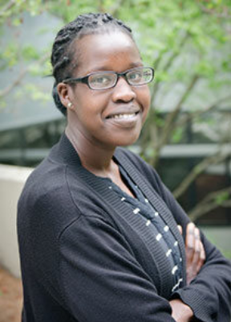
Thank you
South Central Alaska AHEC
www.scahecak.org
www.apcaapprentice.com
Mari Selle, Director
907.786.4595
Mariko.Selle@providence.org

