Slide 1
WIOA Framework & the One Stop System
(Titles I, II, III, & IV)

Slide 2
Workforce Innovation and Opportunity Act (WIOA)
Signed into law on July 22, 2014
Brought about changes to the workforce development integrated system
Created mandatory common performance measures and reporting for core partner programs
six mandatory core partners
Title IB: Adult, Dislocated Workers and Youth
Title II: Adult Education and Literacy
Title III: Wagner-Peyser
Title IV: Vocational Rehabilitation

Slide 3
WIOA Vision
The Workforce Innovation and Opportunity Act (WIOA) was created to provide state and local areas the flexibility to collaborate across systems in an effort to better address the employment and skill needs of current employees, jobseekers, and employers. WIOA accomplishes this by prescribing:
A stronger alignment of the workforce, education, and economic development systems
Improving the structure and delivery in the system to assist America’s workers in achieving a family-sustaining wage while providing America’s employers with the skilled workers they need to compete on a global level.

Slide 4
Alaska Workforce System, who are our partners? There are eighteen required partner programs that form the workforce system in Alaska. The partners work collectively to leverage resources and enhance our shared customers experience. All workforce partner programs and services are made available and/or accessible through the Alaska Job Center Network.
WIOA Title IB: Adult (Alaska DOLWD) Core Program Partner
WIOA Title IB: Dislocated Worker (Alaska DOLWD) Core Program Partner
WIOA Title IB: Youth (Alaska DOLWD) Core Program Partner
WIOA Title II: Adult Education (Alaska DOLWD) Core Program Partner
WIOA Title III: Wagner-Peyser Employment Services (Alaska DOLWD) Core Program Partner
WIOA Title IV: Vocational Rehabilitation Services (Alaska DOLWD) Core Program Partner
WIOA Title ID: Migrant & Seasonal Farm Workers (Alaska DOLWD)
WIOA Title ID: Native American Programs (various – largely utilizing Alaska Native Coalition of Employment and Training)
Unemployment Insurance (Alaska DOLWD)
Jobs for Veterans State Grant (Alaska DOLWD)
Trade Adjustment Assistance (Alaska DOLWD)
Career & Technical Education (Alaska DEED)
Community Service Block Grant (Alaska DCCED/RurAL CAP)
Housing and Urban Development (Alaska Housing Finance Corporation)
Job Corps (Alaska Job Corps)
Reentry Employment Opportunities/Second Chance Act (AK DOC)
Senior Community Services/MASST (Alaska DOLWD)
Temporary Assistance for Needy Families (Alaska DHSS)

Slide 5
The One-Stop Delivery System
One-Stop = American Job Center = Alaska Job Center. Its all in the name and the branding!
In general, the one-stop delivery system is a system under which entities responsible for administering separate workforce investment, educational, and other human resource programs and funding streams (referred to as one-stop partners) collaborate to create a seamless system of services and improve long-term employment outcomes for individuals receiving assistance.
Title I of WIOA assigns responsibilities at the local, State and Federal level to ensure the creation and maintenance of a one-stop top delivery system that enhances the range and quality of workforce development services that are accessible to individuals seeking assistance.
The system must include at least one comprehensive physical center in each local area.

Slide 6
The One-Stop Delivery System (continued)
A comprehensive one-stop center is a physical location where job seeker and employer customers can access the programs, services, and activities of all required one-stop partners. A comprehensive one-stop center must have at least one title I staff person physically present (intent is the direct delivery of Individual Training Accounts).
The comprehensive center must provide:
Career services
Access to training services
Access to employment and training activities under 134(d) of WIOA
Access to one-stop partner programs and activities
Workforce and Labor Market Information
“Access” is defined as:
Program staff physically present
Having a staff from a different partner physically present and appropriately trained to provide information to the customers about the programs, services, and activities available through the partner programs; or
Making available a direct linkage through technology to program staff that can provide meaningful information or services

Slide 7
The One-Stop Delivery System (continued)
While each local area must have at least one comprehensive center, WIOA section allows for arrangements that may include:
A network of affiliated sites that can provide one or more partners’ programs, services and activities at each site.
A network of one-stop partners through which each partner provides services that are linked, physically or technologically, to an affiliated site that assures individuals are provided information on the availability of core services in the local area; and
Specialized centers that address specific needs, such as those of dislocated workers.
The design of the local area’s one-stop delivery system, including the number of comprehensive centers and the supplementary arrangements, must be described in State plan and be consistent with the Memorandum of Understanding executed with the one-stop partners.

Slide 8
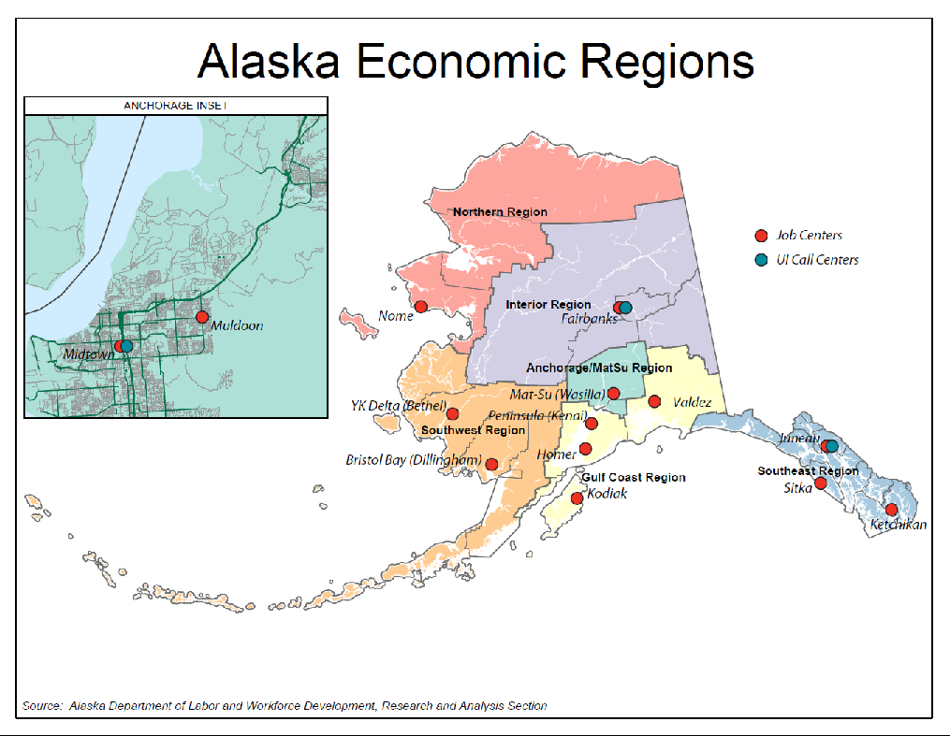

Slide 9
Job Centers
Comprehensive:
Anchorage Midtown
Mat-Su
Fairbanks
Peninsula (Kenai)
Juneau
Ketchikan
Affiliate:
Anchorage Muldoon
Nome
YK Delta (Bethel)
Bristol Bay (Dillingham)
Homer
Kodiak
Valdez
Sitka

Slide 10
DETS - Service Delivery Backbone
The majority of the activities provided by DETS program staff in the Job Centers are done through the WIOA service structure of:
Basic career services
Individualized career services
Follow-up services
Training services
The federal programs that support the majority of DETS staff and their participants are:
Wagner-Peyser/Employment Service
WIOA Adult
WIOA Dislocated Worker
Jobs for Veterans State Grant
There are many additional programs and priorities, required and not required, that are either independently funded or supported by DETS major programs. Examples include:
State Training and Employment Program (STEP)
Foreign Labor Certification
Fidelity Bonding
Apprenticeship (both integrated and specific grant efforts)
Reemployment Services and Eligibility Assessment

Slide 11
Training
Intensive
Core

Slide 12
Individualized Career Services
Follow-up Services
Basic Career Services
Training Services

Slide 13
Basic Career Services
WIOA Title IB initial eligibility determination/referral
Outreach, intake, and orientation to one-stop services
Individualized Career Services
Comprehensive and specialized assessments
Training Services
Occupational skills training
Initial Assessment of skill levels, abilities, skill gaps, and service needs
Job search and placement assistance
Job placement and job development activities
Referrals to and coordination of other programs and services
Unemployment Insurance claimant assistance
Career planning and counseling – Individual Employment Plan
Short-term pre-vocational services
Labor Market Information
Occupation Information
Employer Services
ETPL information
Financial aid application assistance
Internships and work experiences that are linked to careers
Workforce preparation activities
Financial Literacy
Out-of-area job search and relocation assistance
English language and integrated education and training programs
On-the-job training
Incumbent worker training
Skills upgrading
Entrepreneurial training
Adult education and literacy activities
Customized training (conducted in partnership with employers)
Follow-up Services
Services to ensure job retention, wage gains, and career progress for participants who have been referred to unsubsidized employment
Apprenticeships

Slide 14
WIOA One-Stop Partners How Do We Work Together?
Laws, regulations, policy
Common Reporting (for core partners)
Common Mission
RELATIONSHIPS
Local level (who is your partner for program “x”)
Organizational relationships
Person-person relationships
Nothing builds a relationship better than working together
One Stop Academies
Occurring in major centers and expanding

Slide 15
YOU
Wagner-Peyser/Employment Services
WIOA Dislocated Worker
DVR
WIOA Adult
Other WIOA and non-WIOA Partners
WIOA Youth
Alaska Adult Education

Slide 16
Title IB: Adult and Dislocated Worker
The Adult and Dislocated Worker Programs play a key role in helping Alaskan’s find dignified and meaningful work.
Both programs assist Alaskans with the following service structure and often in co-enrollment with other WIOA partner programs:
Basic career services
Individualized career services
Follow-up services
Training services
Both programs can either be a pathway to the middle class or an opportunity to maintain and build skills to remain in the middle class.
The Adult Program focuses on serving “individuals with barriers to employment”. While the Dislocated Worker Program is designed to assist workers affected by a business closure or layoff.

Slide 17
Title IB: Adult
The WIOA Adult program improves the quality of the adult workforce, reduces welfare dependency, and enhances the productivity and competitiveness of Alaska’s workforce.
Adult Eligibility:
Age 18 or older
In need of workforce services, training or retraining to secure unsubsidized employment
Priority is given to veterans, low-income individuals, individuals who are basic skills deficient and recipients of public assistance

Slide 18
Title IB: Dislocated Worker (DW)
The WIOA Dislocated Worker program provides a variety of services to workers who have been impacted by plant closures, workforce reductions, and natural disasters that lead to job loss.
DW Eligibility:
Unemployed and have lost their job through no fault of their own
Have received a layoff notice and are unlikely to return to their previous industry or occupation
Veterans receive priority of service

Slide 19
Title IB: Dislocated Worker Rapid Response
A federally-funded, early intervention service that assists both employers and employees affected by layoffs or plant closures
Purpose:
Promote economic development and vitality by developing an ongoing, comprehensive approach to identify, plan for and respond to mass layoffs and dislocations and preventing or minimizing their impact on workers, businesses and communities
Services:
Informational and direct re-employment services for workers
Delivery of solutions to address the needs of businesses
Convening, brokering, and facilitating the connections, networks and partners to provide assistance to dislocated workers
Strategic planning, data gathering, and analysis
Layoff aversion activities

Slide 20
Title IB: Adult and Dislocated Worker Eligible Training Provider List (ETPL)
List includes all training programs approved to receive federal training funding through the Workforce Innovation and Opportunity Act (WIOA)
Ensures training providers and programs meet minimum standards of participant performance rates:
Completion
Employment
Earnings upon Completion
Credential Attainment

Slide 21
Title IB: Adult and Dislocated Worker SY19
WIOA Adult
424 participants
245 participants enrolled in training
WIOA Adult
WIOA Dislocated Worker
384 participants
309 enrolled in training

Slide 22
Title IB: Adult and Dislocated Worker Resources
Alaska Job Center Network
jobs.alaska.gov
Job Center locations and contact
jobs.alaska.gov/offices/index.html
USDOL/Employment and Training Administration
https://www.doleta.gov/wioa/

Slide 23
Title IB: Adult and Dislocated Worker
Questions?

Slide 24
Title IB: Youth
The WIOA Youth Program provides youth with comprehensive services and prepares them for postsecondary education and employment opportunities, educational and occupational skills credentials attainment, and employment.
Federal Program Priorities
Out-of-School Youth – A minimum of 75 percent $$
Work Experience – Not less than 20 percent $$
Focus on Partnering – Co-enrollment with Titles II and IV
State Program Priorities
Neediest Youth
Credential Attainment
Service to rural communities

Slide 25
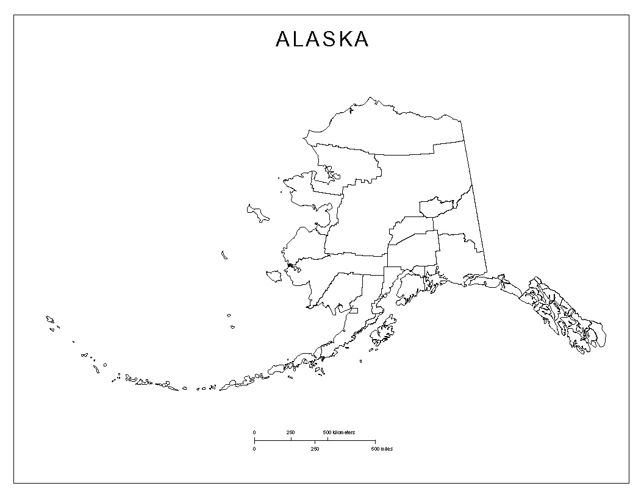
Title IB: Youth
10 project operators 601 (176 in-school & 425 out-of-school) participants served in SFY2019
Literacy Council of Alaska
Yukon Delta Fisheries Development Association
Juvenile Justice
Nine Star
Alaska Military Youth Academy
Alaska Primary Care Association
AVTEC
SERRC
Alaska Works Partnerships
Ketchikan Indian Community

Slide 26
Title IB: Youth
WIOA Performance Indicators
Employment, education, or training during the 2nd quarter after exit
Employment, education, or training during the 4th
quarter after exit
Median earnings during the 2nd quarter after exit
Credential Attainment Rate
Measurable Skill Gains
Effectiveness in serving employers (system-wide measure, not program specific)

Slide 27
Title IB: Youth
Questions

Slide 28
Title II: Adult Education and Literacy
Annually grants receive general funds from the State of Alaska and a grant from the U.S. Department of Education
The goal of the Alaska Adult Education (AAE) Program is to meet student where they are at educationally to facilitate a successful transition in postsecondary education, training, and/or employment.
Adult Ed Programs work with student on Basic Skills, High School Equivalency Diploma Attainment, English Language Acquisition, and Workforce Preparation Courses.
AK Adult Ed Program follows the laws and regulations set forth in WIOA Title II; the Adult Education and Family Literacy Act (AEFLA); Federal Uniform Administrative Requirements; and State of Alaska Statues and Administrative Codes
GED test – High School Equivalency Diploma

Slide 29
The Alaska Adult Education Student
An Adult Education student refers to students who are English language learners and/or studying to increase their ability to:
read, write, and speak (in English) and perform mathematics or other activities necessary for attainment of a secondary school diploma by examination;
transition to postsecondary education and/or training; and/or
obtain employment.
An “English language learner'' refers to a student who has limited ability in reading, writing, speaking, or comprehension of the English language, and--
whose native language is a language other than English; or
who lives in a family or community environment where a language other than English is the dominant language

Slide 30
Eligibility
The student:
is 18 years of age or older;
is physically present in the state;
is not enrolled in a high school program; and
has not received a diploma or certificate through a high school or GED program in another state, province, or U.S. possession.
If a student is 16 or 17 years old, they must meet all of the above eligibility guidelines, with the following additional documentation:
a legal emancipation document or a signed and notarized statement of consent from a parent or legal guardian; and
official documentation of withdrawal from the last school attended in Alaska.
If youth are incarcerated in prison, and have been placed into the custody of the state, they do not need additional documentation to meet eligibility requirements.

Slide 31
Adult Education and Literacy Activities
Refers to programs, activities, and services including:
adult education (reading, writing, mathematics, science, social studies, etc);
workplace adult education and literacy activities;
family literacy activities;
English language acquisition activities;
integrated English literacy and civics education;
workforce preparation activities; or
integrated education and training.

Slide 32
College & Career Readiness
Basic Skills & Pre-Secondary Education
Instruction comparable to educational levels first through eighth grade
Curricula includes, but is not limited to reading, writing, mathematics, science, and social studies
Secondary Education & High School Equivalency Preparation
Curricula is rigorously aligned with the functional level of high school ninth through twelfth grade students
Subjects taught included, but are not limited to, reading, writing, mathematics, science, and social studies
English as a Second Language (ESL) Instruction
Provide instruction to students whose first language is not English
Assists with reading, writing, speaking, and comprehension of the English language
Integrated English Literacy and Civics Education (IELCE)
Assists English language learners, including professionals with degrees and credentials in their native countries, to achieve competency in the English language
Includes instruction in literacy, the rights and responsibilities of citizenship, and civic participation

Slide 33
Adult Education & WIOA Youth Overlap
14 Elements:
Alternative high school services which offer specialized, structured curriculum inside or outside of the public school system.
English language learner, low literacy level, cultural barriers
All title II participants included in this category
Credential Attainment

Slide 34
Questions??

Slide 35
Title III: Wagner-Peyser
The basic purpose of the Employment Service is to improve the functioning of the nation’s labor markets by bringing together individuals who are seeking employment and employers who are seeking workers.
Although Wagner-Peyser/Employment Service focuses on providing labor exchange services, WIOA allows for a broader use of these funds that are under the umbrella of WIOA basic career services.
Labor exchange services
Job search assistance, job referral, and placement assistance for job seekers
Referral information for partner programs and services
Recruitment services for employers with job openings
All basic career services (including labor exchange services)
Re-employment services to unemployment insurance claimants

Slide 36
Title III: Wagner-Peyser Service Delivery
Alaska Labor Exchange System (ALEXsys)
Online presence
Job search, matching, application (job seekers)
Job Positing (employers)
Labor Market Information
Partner service information
Alaska Job Centers
14 locations
Staff assisted services
Staff outreach

Slide 37
Title III: Wagner-Peyser Job Seeker Services
Job Seeker Services
Basic career services
Universally accessible and available to all individuals seeking employment and training services
Generally involve less staff time and involvement
Referrals to other services (not limited to WIOA partner programs)
Examples: eligibility determinations, initial skill assessments, labor exchange services, provision of light information on programs and services, and program referrals
Individualized career services
Must be provided to participants after Alaska Job Center staff determine that services are required to retain or obtain employment
Generally involve significant staff time and customization to each individual’s need
Examples: specialized assessments, developing an individual employment plan, work experiences, workshops

Slide 38
Job Center Resource Rooms
Job Center resource rooms provide space and equipment to access various workforce program services.
14 locations throughout the state
299 public access computer workstations
Copying, scanning, etc.
Workshops
In addition to services delivered individually, jobseekers may sign up for various workshop offerings. Offerings are location specific.
Resume/Cover Letter Writing
Workplace Alaska
Employment After Incarceration
Federal Employment Applications
Interviewing Skills & Mock Interviews
TABE Testing
WorkKeys Assessments

Slide 39
Title III: Wagner-Peyser Employer Services
Develop and maintain strong, long-term relationships between Job Center staff and employers.
Labor Exchange
Job posting, job matching, and referral
Recruitment sessions
Interviewing space
Job fairs
Individualized assistance
Registered Apprenticeship program development
Fidelity Bonding
Work Opportunity Tax Credit
Youth employment
Referrals to other services
Veteran employment
Referral, job development, and Alaska Veteran Employment Tax Credit

Slide 40
Title III: Wagner-Peyser FY19
88,899 visits were made to an Alaska Job Center resource room.
35,788 staff assisted services were provided to 26,794 individuals in Alaska’s Job Centers
51,391 individual registrations were created in the Alaska Labor Exchange System.

Slide 41
Title III: Wagner-Peyser Resources
Alaska Job Center Network
jobs.alaska.gov
Job Center locations and contact
jobs.alaska.gov/offices/index.html
USDOL/Employment and Training Administration
https://www.doleta.gov/programs/wagner_peyser.cfm

Slide 42
Title III: Wagner-Peyser
Questions?

Slide 43
Welcome to DVR 101 Training

Slide 44
Overview
How does ADVR carry out our Mission & Principles?
Who are eligible for ADVR Services?
What are the VR Processes?
What services are available at ADVR?
What the new bill (WIOA) means for People with Disabilities?

Slide 45
Who Are We?
ADVR helps Alaskans with disabilities get and keep good jobs
State Agency - part of the Alaska Dept. of Labor & Workforce Development
Provides services throughout Alaska from five regions
Anc-W; Anc-ER; MatSu-Kenai; Northern; SE
Find the DVR office that serves your area:
http://www.labor.state.ak.us/dvr/contact.htm

Slide 46
Mission
Assist Alaskans with disabilities to OBTAIN and MAINTAIN employment
Principles
The empowering value of employment in an individual’s life
Honoring and respecting each individual’s strengths, skills, choices, abilities and cultural identity
Developing strong partnerships with Tribal vocational rehabilitation programs, schools, job-centers and centers for independent living
Delivering high quality vocational rehabilitation services
Employing and developing highly qualified and skilled rehabilitation staff.
The principles of stewardship in the use of public resources

Slide 47
How does ADVR carry out our mission & principles?
Intended to assist individuals with disabilities to successfully achieve, LONG-TERM, INTEGRATED COMPETATIVE EMPLOYMENT including SELF-EMPLOYMENT based on their abilities, strengths, interests, resources, priorities, concerns, abilities, capabilities, and interests, through an “informed choice” model.

Slide 48
Has impairment
physical
mental
The impairment results in
a substantial impediment to employment
VR Services are required
To prepare for, secure, retain or regain employment
Consistent with the person’s strengths, resources, priorities, concerns, abilities, capabilities, interests, & informed choice
Must meet ALL 3 criteria
(Determined by a DVR CRC)

Slide 49
What about people who are receiving SSI or SSDI?
The first two criteria
- are satisfied as long as the DVR counselor receives documentation of these benefits.
the 3rd criterion (VR Services are required) must still be addressed.
Employment goal, justification, person-centeredness plan

Slide 50
ADVR Process
Orientation
Application
Intake
Determine Eligibility
(60 days)
Develop Individualized Plan for Employment (IPE)
(90 days)
Provide identified Services
Employment
(90 days follow-up)
Successful Closure

Slide 51
What if the significance of the person’s disability becomes an obstacle to receive employment?
Participate in Trial Work Experience
in a real work setting
Max. 3; no more than 3 weeks each (ADVR recommends)
Help VRCs to better determine DVR services

Slide 52
Free Services
Counseling - especially about disability issues that affect you.
Guidance - help choosing the job goal that’s right for you.
Referral - to other agencies that can help you.
Medical Exam - to see if you qualify & to help plan your career.
Tests and other tools to better understand your talents, etc.
On-the-job training with a real employer while you work.
A short-term job try-out called a “Community Assessment.”
Training designed for you, to help you adjust to working.
Job search and placement services.
Interpreter, reader, and tutoring services.
Post-employment assistance

Slide 53
Services Clients May Help Pay For
All training (except on-the-job training)
Books, training supplies, tools, equipment (including computers), and other supplies.
Living expenses, see your counselor for details.
Transportation (getting from place to place).
Medical care and therapy
Self-employment.
Devices that help with your disability.
Services to family members
Work licenses.
Any other goods or services.
Clients and counselors will decide together for the service costs.

Slide 54
Let’s talk about WIOA…..
What WIOA means for People with Disabilities
Passed in July 2014
Includes the Rehabilitation Act of 1973 as amended
Changes core performance measures

Slide 55
Supported Employment (SE)
SE is integrated competitive employment, or an individual working on a short-term basis in an integrated employment setting towards integrated competitive employment. Customized Employment is now included within the definition of SE. Also, the standard post-employment support services under SE has been extended from 18 to 24 months.

Slide 56
Who is eligible for SE Services?
ADVR provides SE to any individual, including a youth with a disability, if: The individual has been determined eligible with a most significant disability; SE has been identified as the appropriate employment outcome for the individual on the basis of a comprehensive assessment of rehabilitation needs, including an evaluation of rehabilitation, career, and job needs.

Slide 57
Supported Employment State Grants
50% of the funds received under the SE Grants are used to support youth with the most significant disabilities (MSD) Youth may receive extended services for up to four years.

Slide 58
Competitive Integrated Employment
Full-time or part-time work at minimum wage or higher, with wages and benefits similar to those without disabilities performing the same work, and fully integrated with co-workers without disabilities. This is the ultimate goal of VR.

Slide 59
Increased VR Role in Transition
15% of federal VR funds are to be used for pre-employment transition services (Pre-ETS) Services include: Cob exploration counseling Work-based learning experiences Counseling on post-secondary opportunities Workplace readiness training and independent living Instruction in self-advocacy
Source: WIA is now WIOA: What the new bill means for people with disabilities, David Hoff, Institute for Community Inclusion, UMass Boston, August 2014
http://www.communityinclusion.org/pdf/IB31_F.pdf

Slide 60
Pre-Employment Transition Students
Who
Students with disabilities
Typically not employed
Funds
Youth who are in school
Business Partnerships
Focus
Develop work experience & soft skills
Time management, responsibility, communication skills; customer service, basic employability

Slide 61
ADVR FY19 Achievements
2,780 people received VR Services
95.6% of ind. receiving VR Services were SD or MSD
Average wage: $15.10/hr
944 students rec’d Pre-ETS
Source: ADVR State FY2019 Program Highlights

Slide 62
Resources
ADVR Website: http://www.labor.state.ak.us/dvr/home.htm
ADVR Offices: http://www.labor.state.ak.us/dvr/contact.htm
34 CFR 361 Regulations on State VR Services Program:
https://www.ecfr.gov/cgi-bin/text-idx?SID=b1ef6bf2d4756a591cee7c4ded6d432d&mc=true&node=pt34.2.361&rgn=div5

Slide 63
Questions?
Call your local DVR office to talk with a Vocational Rehabilitation Counselor or Regional Manager to help get your questions answered.

