Slide 1
New Assistive Technologies to Improve Adult Literacy
By
Bridget Clark, M.Ed.
Kenai Peninsula College
Soldotna, AK

Slide 2
Approximately 32 million adults in the United states Can’t Read
*** U.S. Department of Education and The National Institute of Literacy, Feb. 16, 2018

Slide 3
Technology Can Help

Slide 4
Technology Areas
Text-to-Speech
Speech-to-Text
Writing
New Apps

Slide 5
Text to Speech
Learning Ally
* Largest library of human-read audio books and resources
* Annual membership $135 provides access to qll services
* All books are fully accessible
* Includes on-screen highlighted text synced with audio narration

Slide 6
Text to Speech Apps - iOS
VoiceOver
* Designed for iPad, iPhone, and other Apple products
* No downloads required
Negatives:
*Student needs instruction and practice to navigate
* VoiceOver changes the gestures you use to control the iPad
* Apple has a user guide to help with VoiceOver

Slide 7
Text to Speech Apps - Android
Android
* Samsung Galaxy, etc
* Voice Assistant
*Offers a tutorial
* Shake the phone for continuous reading
* Option to speak passwords
*Verbosity setting
*pitch changes
*phonetic alphabet

Slide 8
Speech to Text
Dragon Naturally Speaking
Natural Reader
* Free
* Use Google Drive, Dropbox, OneDrive or iCloud to upload and listen to documents
* Premium users can take pictures of books to listen to

Slide 9
Speech to Text
Google Text – to – Speech
* Converts text into speech in more than 180 voices and more than 30 languages
Google Chrome
* Read-aloud extension
* works with Firefox
*converts webpage text to audio
*blogs, news sites, textbooks, school and class websites, online universities and course materials

Slide 10
Speech to Text Apps
Evernote
* Free app
* Share notes, annotate images, and collaborate
* Works on any device
Just Press Record
* $5
* Record anything and have it transcribed into text
* Files save on device or on iCloud
Dragon Anywhere
* Free download but in-app subscription needed to access all features
* Upload notes and documents to iCloud or Dropbox

Slide 11
Writing Aids
Smart Pens
* Bluetooth syncs handwritten notes to mobile device
*Uses high-speed IR camera to record
* Syncs recorded audio to writing
*Many devices available across price ranges
Negatives:
Cost $50 to $200
Not devices are all compatible with paper, etc

Slide 12
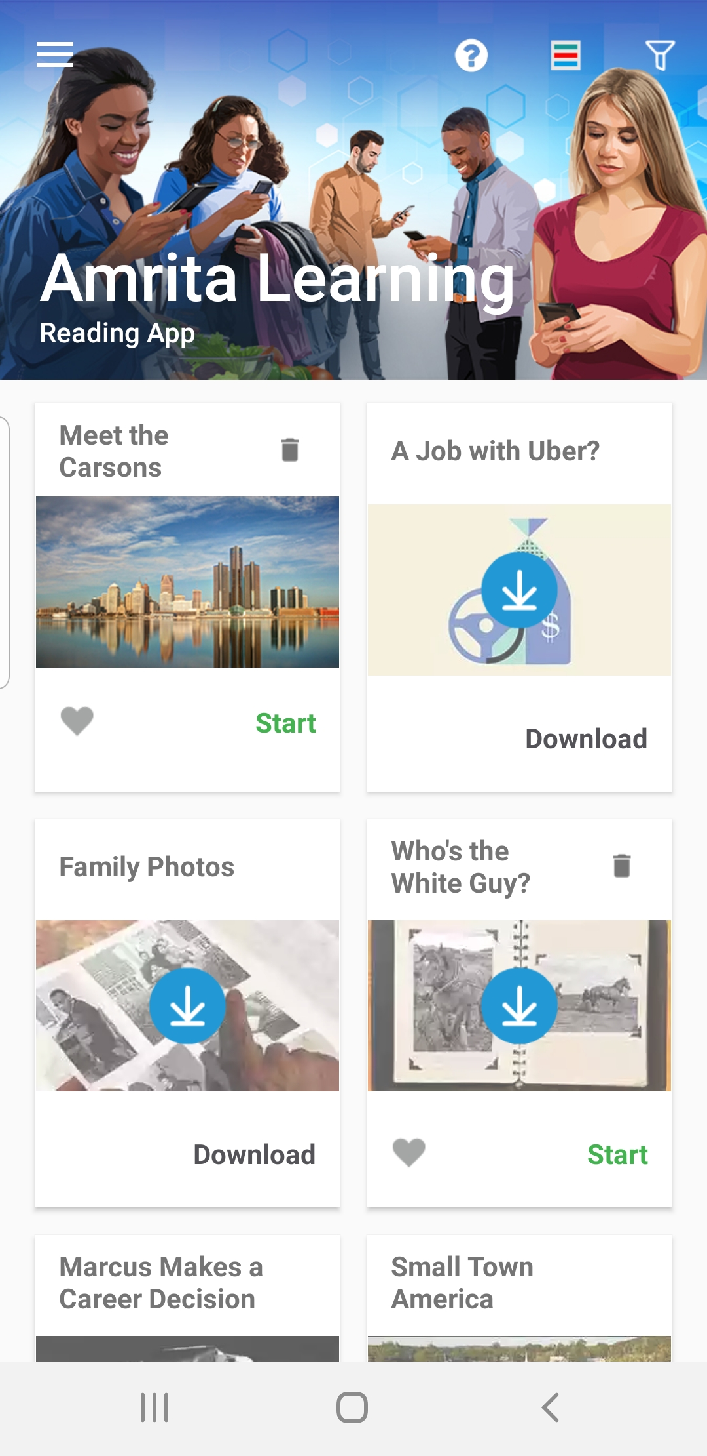
Amrita Learning

Slide 13
Amrita Learning
- Pro Literacy’s XPRIZE winner, and finalist for the Barbara Bush Foundation Adult Literacy XPRIZE competition
What I liked about this app:
- Multi-level
- Designed for adults
- Incorporates phonics, picture dictionary, reading and games
Negatives:
- only for Android phones
- had difficulty downloading with new Samsung Galaxy

Slide 14
CODEX: The Lost Words of Atlantis

Slide 15
Codex: The Lost Words of Atlantis
What I liked:
Great graphics which will appeal to students
Features common to most video games
Negatives:
Only available on Android phones
- Directions were complicated, particularly for English Language Learners

Slide 16
References
11 Best speech-to-text apps for Android and iOS 2019. https://freeappsforme.com/speech-to-text-apps/
Carter, J. (2017). Expanding access to learning with mobile digital devices. Journal of research and Practice for Adult Literacy, Secondary and Basic Education, v.6 n2 p 49-54.
Day, S.L. and Edwards, B. (1996). Assistive technology for postsecondary students with learning disabilities. Journal of Learning Disabilities, vol 29 (5). pp. 486-492.
Flipowicz, L. and Chan. C. (2019). Best apps for voice to text transcription on iPhone and iPad in 2019. Aug. 13. https://www.imore.com/best-apps-transcribing-voice-text
Gregg, N. (2012). Increasing access to learning for the adult basic education learner with learning disabilities: Evidence-based accommodation research. Journal of Learning Disabilities 45(I) 47-63.
DOI: 10.1177/0022219411426855
Pogue, D. (2018). VoiceOver features: http://finance.yahoo.com/news/david-pogue-on-iphonevoiceover-163733668.html

