Slide 1
Strategies and Resources for Multilevel English Language Learners
Teresa Barton: Prince William Sound College

Slide 2
Multilevel Classes
Definition
Context
Challenges
English language learners with a wide range of English proficiency, beginning to advanced, that are placed together instructionally in a single group (Mathews-Aydinli & Van Horne, 2006).
Given that many of our programs are small, this is a reality for many adult education classrooms.
In addition, student attendance may be sporadic.
Teachers must spend extra time preparing lessons and materials and need greater program support.
Having a stash of material can make life easier.

Slide 3
Multilevel Learning Strategies
Needs Assessment
Detailed Lesson Planning
Activities
Through intake or informal interviews it is important to figure out what students really want to learn.
Skills assessment
Flexibility is key
Leveled books/curriculum
Multilevel worksheets
Grouping
Role Plays
Visuals or realia
Thematic Instruction
Film/Videos
Extra activities for students that tend to finish first
Activities promote collaboration.
Homework based on level

Slide 4
Curriculum Resources
Ventures Cambridge
Oxford Picture Dictionary Vocabulary
ESL Library Website
iSL Collective Printables/Videos
Chasing Time English TV Shows
Film English Videos
We Speak NYC Civic Focused Learning
Kentucky Educational Television Public TV
TEFL Tunes Songs
Breaking News English News
British Council Lesson Plans
Unsplash Pictures
New York Times Images Picture Prompts

Slide 5
Sample Lesson Plan

Slide 6
Theme: Friends and Family (SIOP Lesson Plan)
Background: This is a 90 minute ESL class for multilevel adults.
Content Objective: Students will be able to further develop friends and family vocabulary and describe relationships between family and friends.
Language Objective: Students will be able to read a story related to family interactions and orally describe their own friends and family.
Grammar Objective: Present Continuous
Materials: Oxford Picture Dictionary, Ventures Unit 3, ESL Film English (Penelope in the Treehouse), photo prompt, discussion questions (ESL Library), Song (YouTube)

Slide 7
Key Concepts and Vocabulary
Oxford Picture Dictionary on Friends and Family: Friends, grandmother, grandfather, mother, father, sister, brother, aunt, uncle, cousin, wife, husband, son, niece, and nephew
Concepts: Marriage, divorce, in-laws, step relatives versus half relatives
See Oxford Dictionary handout.

Slide 8
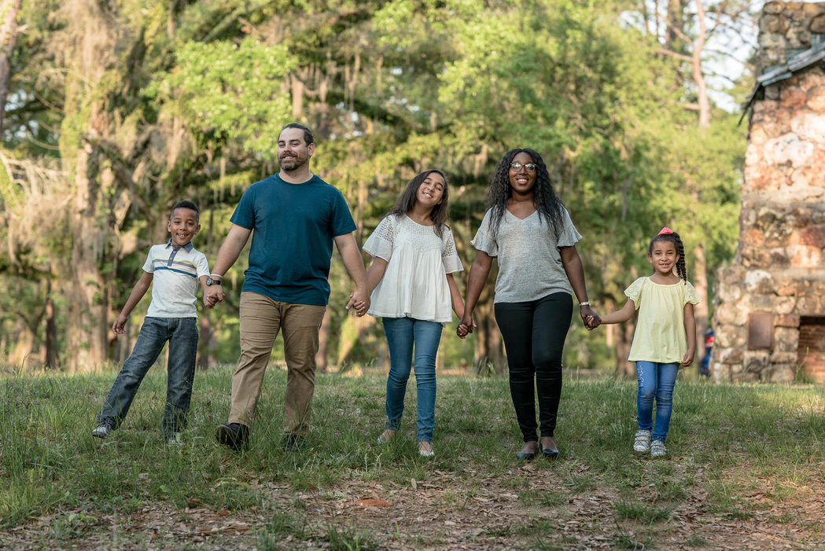
Introduction/Motivation (Picture Prompt)

Slide 9
Penelope in the Treehouse
Lesson Plan based on short movie at Film English

Slide 10
Speaking Application
Questions about the movie:
Let’s discuss Penelope’s new family (draw a family tree on the board and label characters and their relation to Penelope).
Why was Penelope upset in the beginning of the film?
What happened at the end? Was she still upset?
Your family: Can use as guided writing or discussion (ESL Library)--I often encourage students to show us their pictures on their phones. Often they have pictures that they are eager to talk about. You can create cloze sentences on the board to help beginners.
How many people are in your family. Can you describe them? Do you have a brother or sister? Husband or wife?
Do you have friends that you are really close to?
Where does your family live?
Do you spend a lot of time with your family?
What kind of activities do you like to do with your family?

Slide 11
Listening, Grammar, and Reading Application
Now we can integrate Ventures Unit 3.
Look at the picture on page 32. What do you see?
Complete the listening activity on page 33.
Introduce grammar concept: present continuous p.34-37
Utilize the photo prompt and Penelope from the beginning of the lesson to further practice the present continuous. This can also be a writing exercise.
What is the son wearing? What is the mother wearing? What are they doing?
What is Penelope doing in the picture? (You can show various clips).
Do the reading component on page 38 and 39.

Slide 12
Review/Assessment
If there is time you can do the writing application in Ventures. This particular lesson, though, offered guided writing or discussion. I do not always have time for all language components. Writing is a good homework assignment since it allows more time.
-Use a family tree to review concepts (The Simpsons).
-Any of these discussion questions/activities can either be done in small groups or as a whole class. In multilevel classrooms make sure to pair more beginner students with advanced students.
-End class with “We Are Family” by Sister Sledge Family

Slide 13
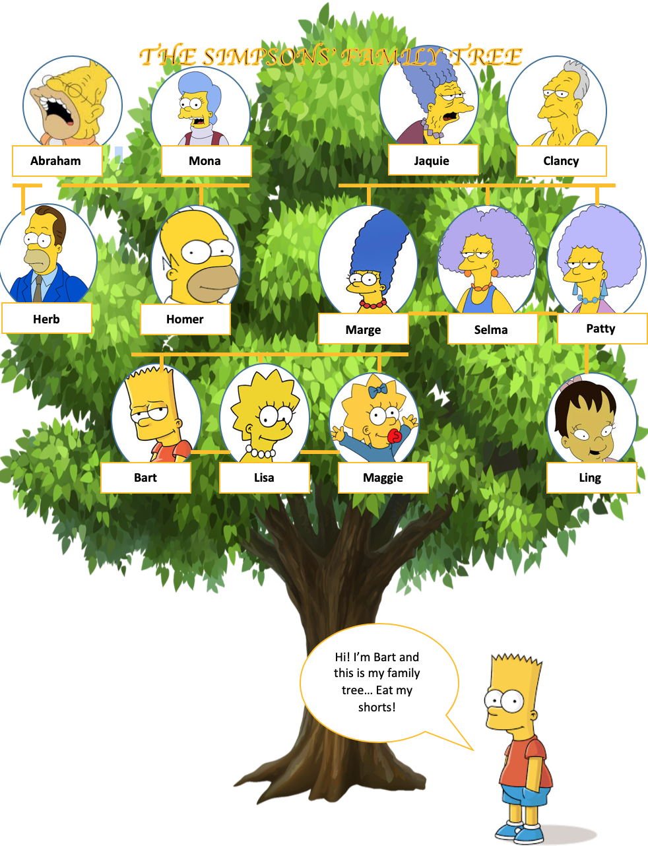
Isl Collective: Worksheet

Slide 14
Works Cited
Mathews-Aydinli, J., & Van Horne, R. (2006). Promoting success of multilevel ESL classes: What
teachers and administrators can do. CAELA. Retrieved from http://www.cal.org/adultesl/pdfs/promoting-the-success-of-multilevel-esl-classes.pdf

