Slide 1
Integrated Education and Training
Roundtable Discussion
Notes:
NOTE:
To change the image on this slide, select the picture and delete it. Then click the Pictures icon in the placeholder to insert your own image.

Slide 2
What is Integrated Education and Training (IET)?
Office of Career, Technical, and Adult Education’s (OCTAE) definition:
A service approach that provides adult education and literacy activities concurrently and contextually with workforce preparation activities and workforce training for a specific occupation or occupational cluster for the purpose of educational and career advancement

Slide 3
Adult Education & Literacy
Workforce Preparation
Workforce Training

Slide 4
What is an example of Contextualized Learning?

Slide 5
Types of Occupational Certificates and/or Credentials
Two categories of occupational certificates and/or credentials that are acceptable to achieve the purpose of an IET program
Recognized postsecondary credential
Other types of credentials or certificates
Occupational credentials must meet the definition of “recognized postsecondary credential” - section 3(52) of WIOA
Industry-recognized certificate or certification
Certificate of completion of an apprenticeship
License recognized by the state or federal government
Other types of credentials or certificates
Certificates document the attainment of general skills that are required to qualify for entry-level employment or advancement in employment and are a part of a career pathway
May include skills related to safety, hygiene, and other general skills.

Slide 6
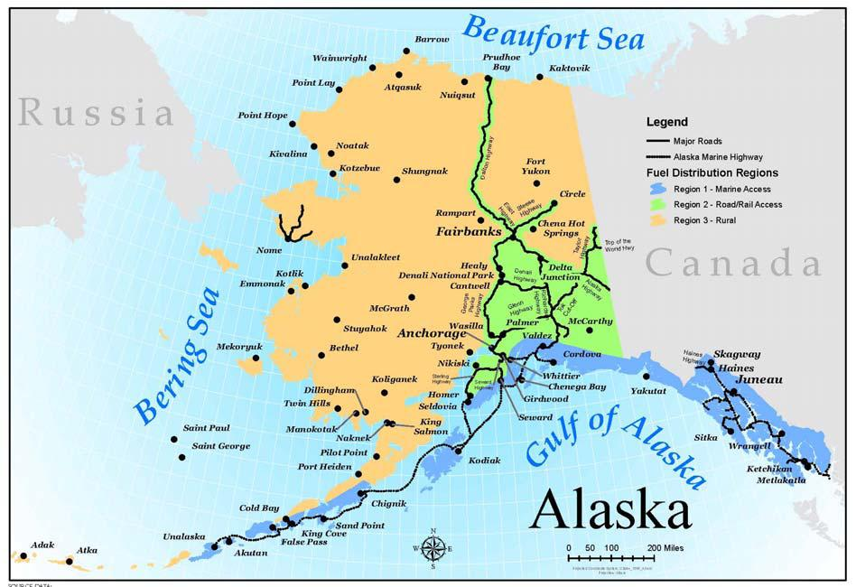
What are the pros/cons to IET?
How can we make this work in AK?
Who are our partners?
Where do we start?
Other questions?

