Slide 1
Using Reading Kits: best practices for teaching reading comprehension
Jeff Smith
SERRC – Alaska’s educational resource center
Southeast Adult Education

Slide 2
Objective
Give me the GIST
In 15 words or fewer, I can describe what reading kits are OR
In 15 words or fewer, I can describe how I might be considering using reading kits in my classroom or program

Slide 3
PAIR-Share
Introduce Yourself
What’s your favorite place you have ever visited?
In 15 words or less, what is your experience teaching reading?

Slide 4
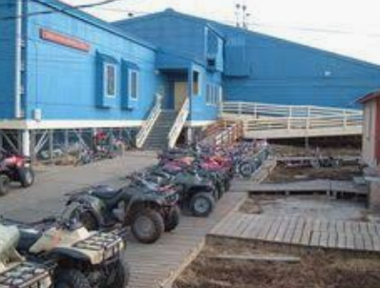
Origin story & RLA

Slide 5
Speaking & Listening Kit
Pronunciation Kit
Reading Kits
Phonics & Phonemic Awareness Kit
Citizenship Kit

Slide 6
Take Their word for it
“Our ESL Instructional Support Kits are designed to make teaching easier! Each kit provides teachers and classroom volunteers with complete activity instructions and materials on a variety of topics.”
https://mnliteracy.org/tools/ESLKits

Slide 8
Each Kit can be downloaded from the MN Literacy Council Website for free!
https://mnliteracy.org/tools/ESLKits

Slide 9
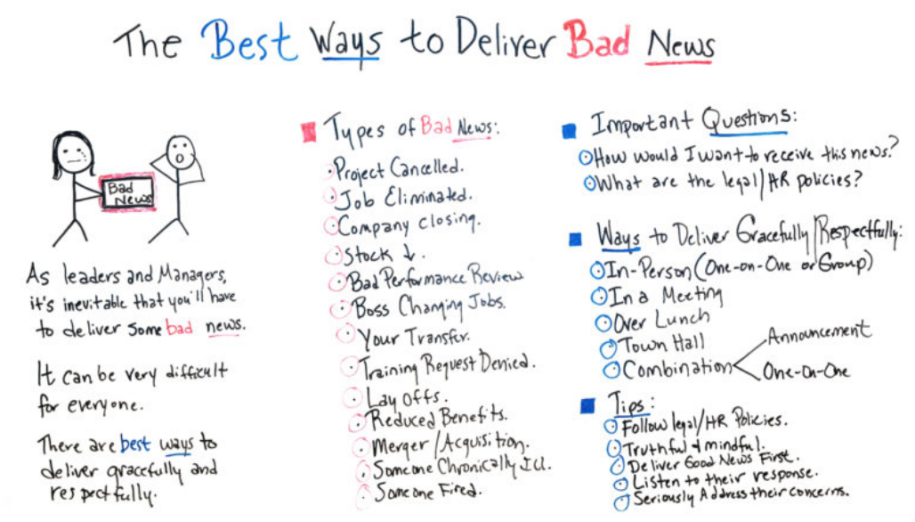

Slide 10
Notes:
Unveil the Kits – Pass one or more to each table -- People can open and look at the inside
Tell about raffle
You might be wondering… “How did MN have the time to develop and assemble all these kits??”

Slide 11
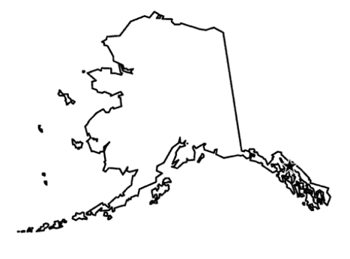
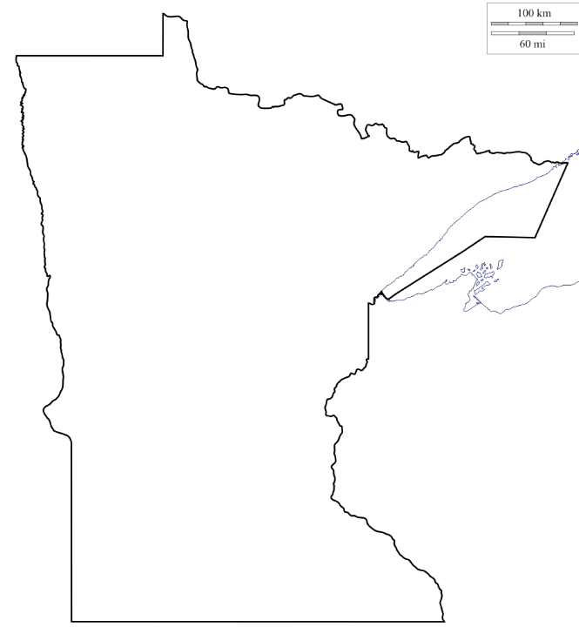
Not in Alaska anymore
$1,200,429 of federal ABE funding
$1,953,500 in state ABE funding
MN = 7.6 times the population of Alaska
Area of AK =
7.2 times larger than Minnesota
$4,000,000 of federal ABE funding
$47,000,000 in state ABE funding
http://mnabe.org/abe-funding-grants

Slide 12
Let’s get to it: The Reading kit
READING KITS CONTAIN (about)
1 Tutor Log
Activity Instruction Cards
12 Laminated Index Cards
6 mini-whiteboards, 6 markers, 2 erasers
6 highlighters
6 KWL Charts
READING KITS DO NOT CONTAIN
Reading Material
Notes:
As the instructor, you pick out the reading to use with the kit

Slide 13
The Reading kit Today’s Reading is for an nrs level 2 reader
Sound Familiar?

Slide 14
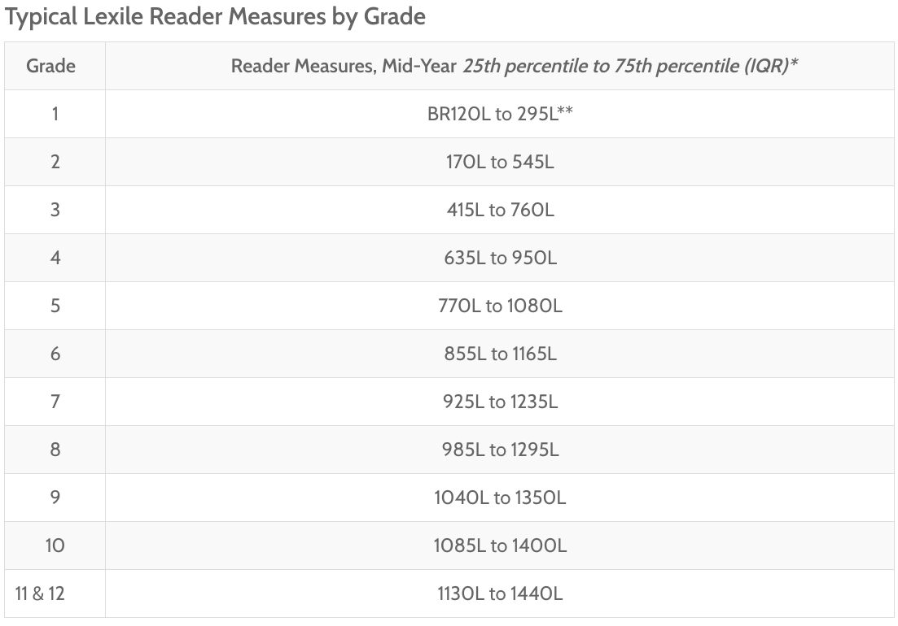
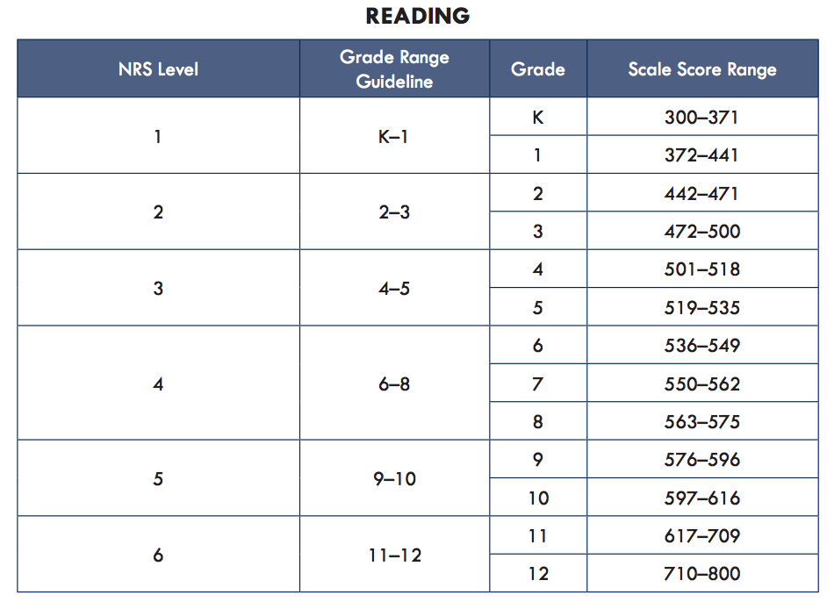
Newsela
https://newsela.com/
https://lexile.com/educators/measuring-growth-with-lexile/lexile-measures-grade-equivalents/
https://tabetest.com/PDFs/TABE_GradeRange.pdf
Notes:
Show how to change lexile level…
Free educators account

Slide 15
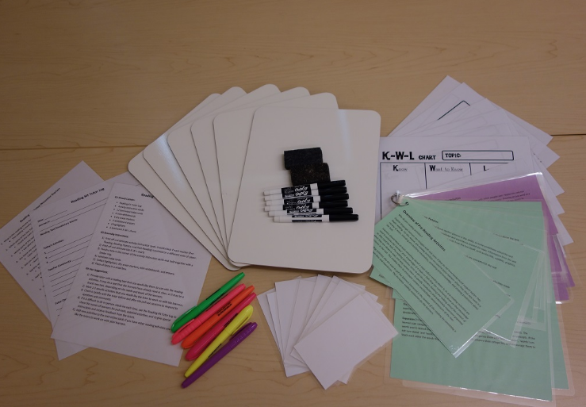
The Reading kit Predictions from pictures Pre-Reading Activity
Notes:
Table leader Selection
If it needs to be quick --- nose goes
If enough time – Find the Cheecako

Slide 17
Link to Article
How were your predictions?

Slide 18
How might you treat this activity differently for a NRS level 4/5 learner?

Slide 19
FROM THEORY TO PRACTICE
All students benefit from learning reading strategies. Providing too many in a short period of time, however, will not allow students to own the strategy themselves
“Students need to learn a reading strategy out of context of the content area in order to effectively assimilate the strategy. Once students no longer need scaffolding using the strategy, application to content area is possible.”
The model for strategy instruction is:
Practice Out of Content Area, slowly removing scaffolds
Direct Instruction & Modeling
Practice & Application of Strategy in Content Area
Rhoder, C. (2002). Mindful reading: Strategy training that facilitates transfer. Journal of Adolescent & Adult Literacy, 45(6), 498–512.
http://www.readwritethink.org/classroom-resources/lesson-plans/gist-summarizing-strategy-content-290.html

Slide 20
Objective
Give me the GIST
In 15 words or fewer, I can describe what reading kits are OR
In 15 words or fewer, I can describe how I might be considering using reading kits in my classroom or program

