Slide 1
Alaska Fall Conference
Anchorage
October 1-3, 2019

Slide 2
Who Is Essential Education?
WHO WE ARE
Notes:
On a scale from 1-3, 1 being the highest, what is your knowledge level of Essential Education?

Slide 3
We are a team focused on:
✓ adult education;
foundational skills;
helping people change their lives and reach their life goals through education;
providing up-to-date, relevant, and engaging content;
incorporating Adaptive Learning in our online/offline study programs to ensure personalization and positive results;
transferable strategies for college, careers and life;
customer service--MOST ESSENTIAL
Notes:
we dont repackage K-12 academic content
we updated all of the lessons and content this past May and replaced Flash content with HTML5. This along with an intuitive and engaging experience for students and instructors as confirmed from our existing customers is what sets us apart. Oh, also the affordability.

Slide 4
Pre-conference survey results (topics to discuss):
Retention
Essential Education Reports
Print Workbooks
Motivation
Offline
Distance Learning
Blended Learning
Basic Literacy Skills

Slide 5
RELEVANT ENGAGING INTUITIVE CONTENT
& RESOURCES
Retention
Motivation

Slide 6
Essential Education
Student’s Homeroom
Online and Offline
ABE & HSE Programs

Slide 7
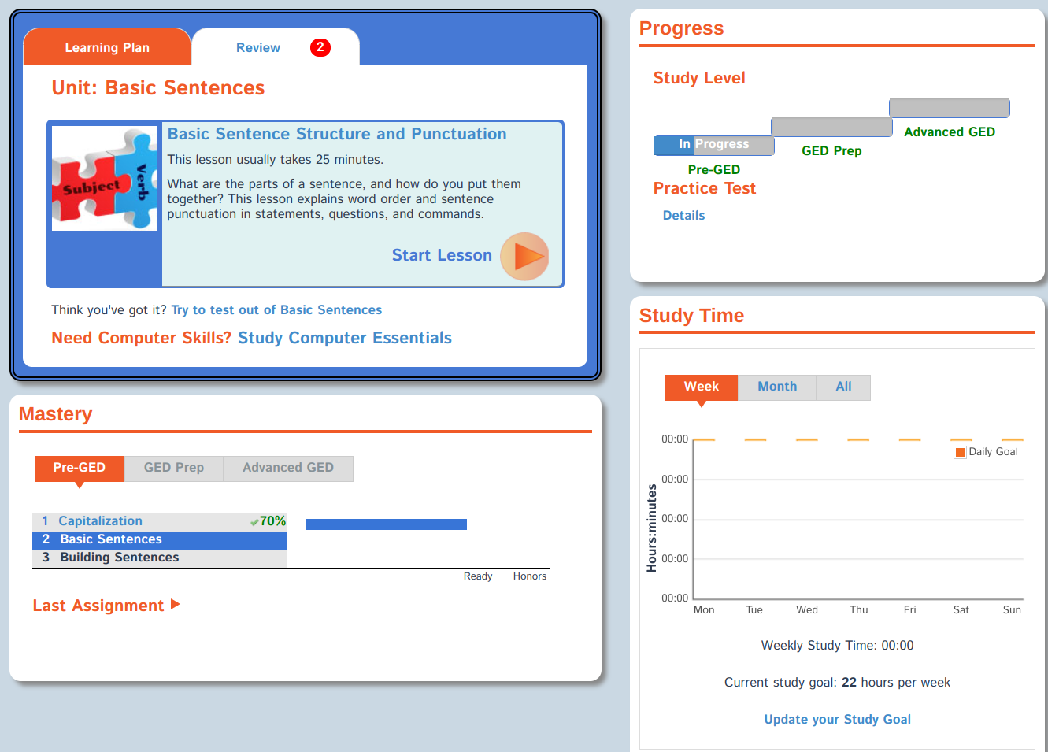
Notes:
Our ABE and HSE online and offline academic programs

Slide 9
Print Workbooks

Slide 10
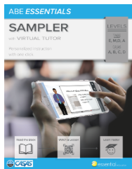
Preparation for HSE Tests and meeting College and Career Ready Standards-4 step lesson and Star rating system
Basic literacy skills in Math/Reading/Language. Correlated to both TABE 11/12 and New CASAS GOALS tests. Available w/VT or without.
Critical thinking, reasoning, test preparation skills and strategies.

Slide 11
Essential Education Reports

Slide 12
Contains time and score information on every lesson, quiz, or practice test attempt

Slide 13
Basic Literacy Skills

Slide 15
Distance Learning
Blended Learning

Slide 16
What Percent of Online vs. Face-to-Face Learning is Required for a Model to be Considered Blended? There is no perfect or universal answer to this question, however, a 2007 Sloan Consortium report, Blending In: The Extent and Promise of Blended Learning in the United States, describes four different course models, only one of which, the third, is truly blended or hybrid learning:
1. 0% online learning describes a traditional face-to-face model.
2. 1-29% online describes a “web-facilitated” course that “uses web-based technology to facilitate what is essentially a face-to-face course.” For example, it uses a course management system (CMS) or web pages to post the syllabus and assignments.
3. 30-79% describes a truly blended (hybrid) model, a course that blends online and face-to-face delivery. A substantial proportion of the content of the course is delivered online, it typically uses online discussions, and typically has some face-to-face meetings.
4. 80+% online is an online or distance learning course where most or all of the content is delivered online. Typically in a purely online or distance learning course there are no face- to-face meetings.

Slide 17
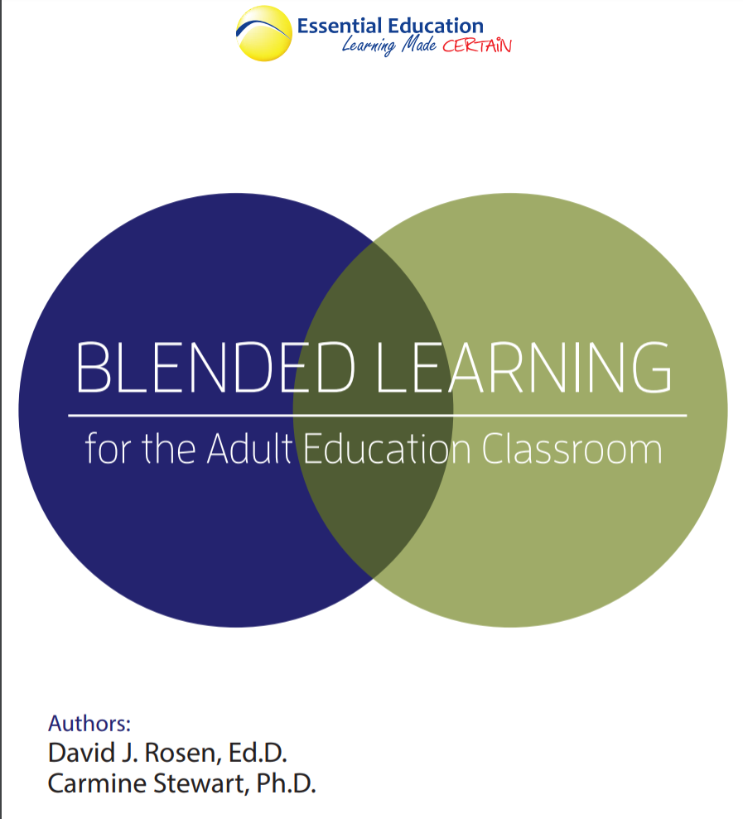

Slide 18
Q & A
*Come by our booth!

Slide 19
Contact Information
John Balentine
john@essentialed.com
602-620-1570

