Slide 1
Pre-Intensive Class Success by Josh Fisher and Mike Husa ABE Instructors at Yuut Elitnaurviat

Slide 2
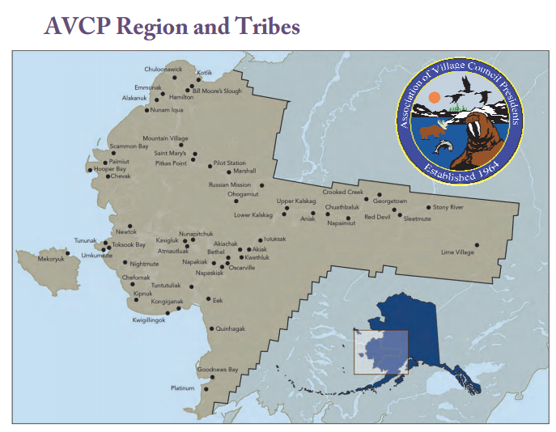
Four times a year we hold GED Intensives (RLA/SS or Math/Science)
for village based students, with up to 12 students in attendance.

Slide 3
Our dilemma, how to identify students who are ready and willing to make the commitment to pass the GED Exams.
TABE Scores
Facilator’s recommendations
Attendance in the village based programs
GED Ready Exam scores

Slide 4
It didn’t work very well!
Not all students were motivated when they arrived.
Not focused on learning and passing the exams.
About 50% of the students passed the GED Exam during
the intensive.

Slide 5
Our solution!
The GED Pre-Intensive
Identify students 4 to 5 weeks prior the intensive.
Contact them, and invite them to participate in the GED pre-intensive.
Expectations of working 8 hours per week
Taking the GED Ready exam, and scoring above 135.

Slide 6
Our engagement:
Weekly phone conversations with the student.
Weekly emails with the student
Contacting Facilators, Tribal Workforce Development Specialist, and/or TANF Case Managers to encourage students.

Slide 7
The Results!
7 students invited to the last GED Intensive held in Bethel.
2 students completed their GED.
5 students took and 5 students passed the GED Math Exam.
6 students took and 5 students passed the GED Science Exam.

Slide 8
The Unintended Results!
Students rested, engaged and excited for the opportunity to pass the exams.
Students voluntarily forming study groups in the evening to help each other.
Students contacting students who did not come to the intensive, but were part of the pre-intensive and encouraging them to get back to studying.

