Slide 1
Adult Education Ambassador Training Presenter: Dr. Judetta Cowden
Notes:
Thank AAEA for the opportunity to represent Alaska at the 2019 COABE conference…

Slide 2
Agenda
Objectives
Ambassadors Program History & Accomplishments
Ambassador Training 4 Components
The Fish Bowl
Elements of an Effective Meeting with a Person in Power
Elements of a Powerful Story for Change
Story Coaching
Tips for Public Speaking
Story Coaching – The Grid
Importance of Pre-Meeting Planning & Preparation

Slide 3
Objectives
Benefits of Empowering Your Students
Power of stories
Public speaking
Planning and facilitating a meeting

Slide 4
History & Accomplishments
Important role and identity as a representational leader
Provide students with 21st century CCR skills development that will help them in their continuing education, careers and as members of the community
Networking for students – current and alumni
Increase visibility of adult education
Goals:
Notes:
Origins
Participatory Practice
Funding Issues
Student Leadership Council
Advocacy and Awareness raising

Slide 5
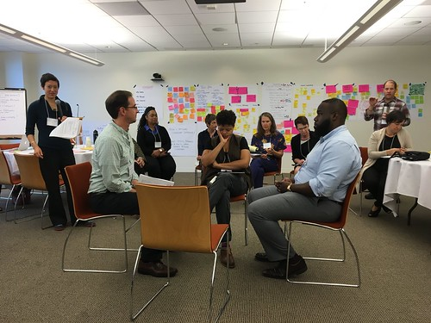
Ambassador Training 4 Components
Awareness
Stories
Public Speaking
Meeting with Officials
Notes:
Awareness – statistics and research about the myth of the Education Pipeline
Stories – most powerful tool to affect change
Public speaking – message & delivery
Meeting with officials – planning, practicing, facilitating meetings with people in power –Fish Bowl

Slide 6
The Fish Bowl

Slide 7
Elements of an Effective Meeting
Open the meeting with introductions
Recognize time
State the purpose of the meeting
Personal Stories
Pose questions
Close the meeting with a re-cap
See Agenda Handout

Slide 8
Elements of a Powerful Story
Who I am - Relevant background
Challenge - Conflict / Struggle / Problem
Achievements & Goals for the future - How adult basic education has changed my life
Who I represent - Others who need / have benefited from adult basic education.
Call to action - What I want the listener or audience to do
Notes:
Who I am - Relevant background
My name is ___ and I come from...
Challenge - Conflict / Struggle / Problem
Some challenges or changes in my life that lead me to study in adult education are...
Achievements & Goals for the future - How adult basic education has changed my life
Since I began studying in Adult Education classes, my life has changed in these ways…..
My plans and goals for the future are…
Who I represent - Others who need / have benefited from adult basic education.
I know that my story/situation represents others who …
Call to action - What I want the listener or audience to do
I hope that people who hear my story will …

Slide 9
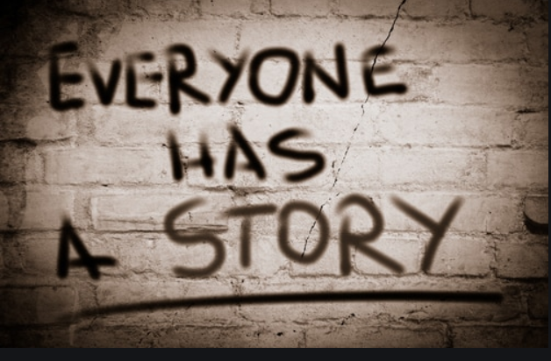
Story Coaching
Message & Delivery: Two Important Aspects of Your Story
Giving Feedback: We the audience have an important job: giving feedback…
Notes:
Message & Delivery: Two Important Aspects of Your Story
Powerful message – words, details, length, main points
Effective Delivery – voice, stance, eye contact, pacing, intonation
Giving Feedback: We the audience have an important job: giving feedback…
What was most powerful about the Message? Delivery?
What suggestions do you have for the Message? Delivery

Slide 10
Tips for Public Speaking
Wear comfortable clothes
Make eye contact
Stand firm
Use visuals & gestures
Use a strong voice
Be aware of how fast or slow you are talking
Make it personal
Explain why your message is important
Be aware of your audience
Encourage participation
Relax and stay positive!
Notes:
Wear comfortable, simple clothes
Make eye contact
Stand firm: Be a tree
Use visuals
Use hand gestures
Use a strong voice … or use a microphone.
Be aware of how fast you are talking
Be aware of how softly you are talking
Make it personal: Use examples and experiences
Explain why what you are saying is important
Be aware of how your audience is reacting
Encourage audience participation
Relax and stay positive!

Slide 11
Story Coaching – The Grid
Name | Values | Challenge | Choice | Outcome
This grid was used to keep track of the details of each story and it helped to provide feedback and remember details.

Slide 12
Pre-Meeting Planning & Preparation
It is extremely important to be prepared before you go into a meeting. Consider the following things:
Know the issue
Know the person
Know the purpose of the meeting and what you
want to ask/learn
Know your roles
Practice!

Slide 13
Achievements
Notes:
Hundreds of ABE students have been trained
Students have facilitated meetings with officials at the local, state and federal levels, hosted public officials at their learning centers, and testified at public government meetings.
Adult education ambassadors have presented at local, state, and national conferences as well as visited the Capitol in Washington DC.
Student voice and public advocacy and awareness raising has led to the survival of adult education – the most disenfranchised educational program that serves the most disenfranchised of our communities – Immigrants and Adult Basic Education and GED students.
Most importantly, our ambassadors program has promoted active civic participation among the students, families, staff, and friends of adult education. That has resulted in a ripple effect into our community – when one family member, neighbor or student gains the experience and confidence to speak up about what they care about – everyone benefits.

Slide 14
Questions
Notes:
Laura Porfirio is an adult educator in Tucson, Arizona at Pima Community College. She has spent her entire 25-year career fostering ways to help students take charge of their learning, break down the walls of the classroom, and promote student engagement in social justice oriented education. Laura has been leading Ambassador leadership training for students and staff in Arizona for almost 10 years. Her current job is to oversee daily operations at a large urban learning center for adults. She is also serving as the President-Elect and the Awareness Committee Chair for the Arizona Association for Lifelong Learning.
With more than forty years in the field of education, Diane Davenport Jackson has provided capacity building, training, and technical assistance in advocacy, strategic planning, and board development to nonprofit leaders in Nicaragua, Pakistan and the US..Clients have included the US Agency for International Development, Mercy Corps, and the International Red Cross, in addition to private sector entities. She is currently an ELAA Instructor and Ambassador Coordinator in the Queen Creek Unified School District Adult Education Program. Diane is also the current President of the Arizona Association for Lifelong Learning.

Slide 15
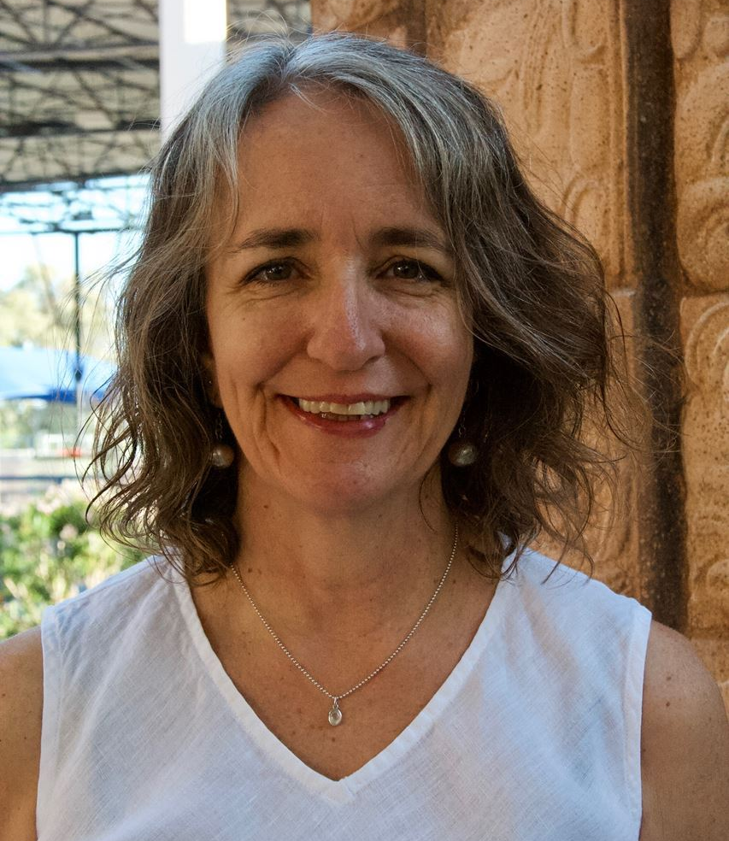
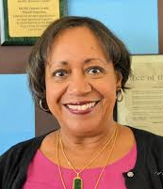
For Additional Information
Laura Porfirio
Tel: (520) 206-3809
Email: lporfirio@pima.edu
Diane Jackson
Tel: (480) 987-5988
Email: djackson@qcusd.org
Notes:
Laura Porfirio is an adult educator in Tucson, Arizona at Pima Community College. She has spent her entire 25-year career fostering ways to help students take charge of their learning, break down the walls of the classroom, and promote student engagement in social justice oriented education. Laura has been leading Ambassador leadership training for students and staff in Arizona for almost 10 years. Her current job is to oversee daily operations at a large urban learning center for adults. She is also serving as the President-Elect and the Awareness Committee Chair for the Arizona Association for Lifelong Learning.
With more than forty years in the field of education, Diane Davenport Jackson has provided capacity building, training, and technical assistance in advocacy, strategic planning, and board development to nonprofit leaders in Nicaragua, Pakistan and the US..Clients have included the US Agency for International Development, Mercy Corps, and the International Red Cross, in addition to private sector entities. She is currently an ELAA Instructor and Ambassador Coordinator in the Queen Creek Unified School District Adult Education Program. Diane is also the current President of the Arizona Association for Lifelong Learning.

Slide 16
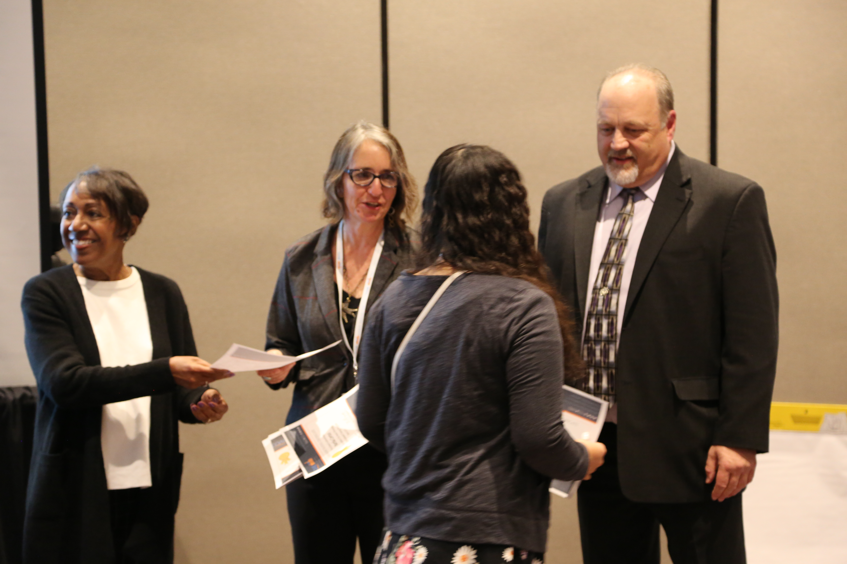
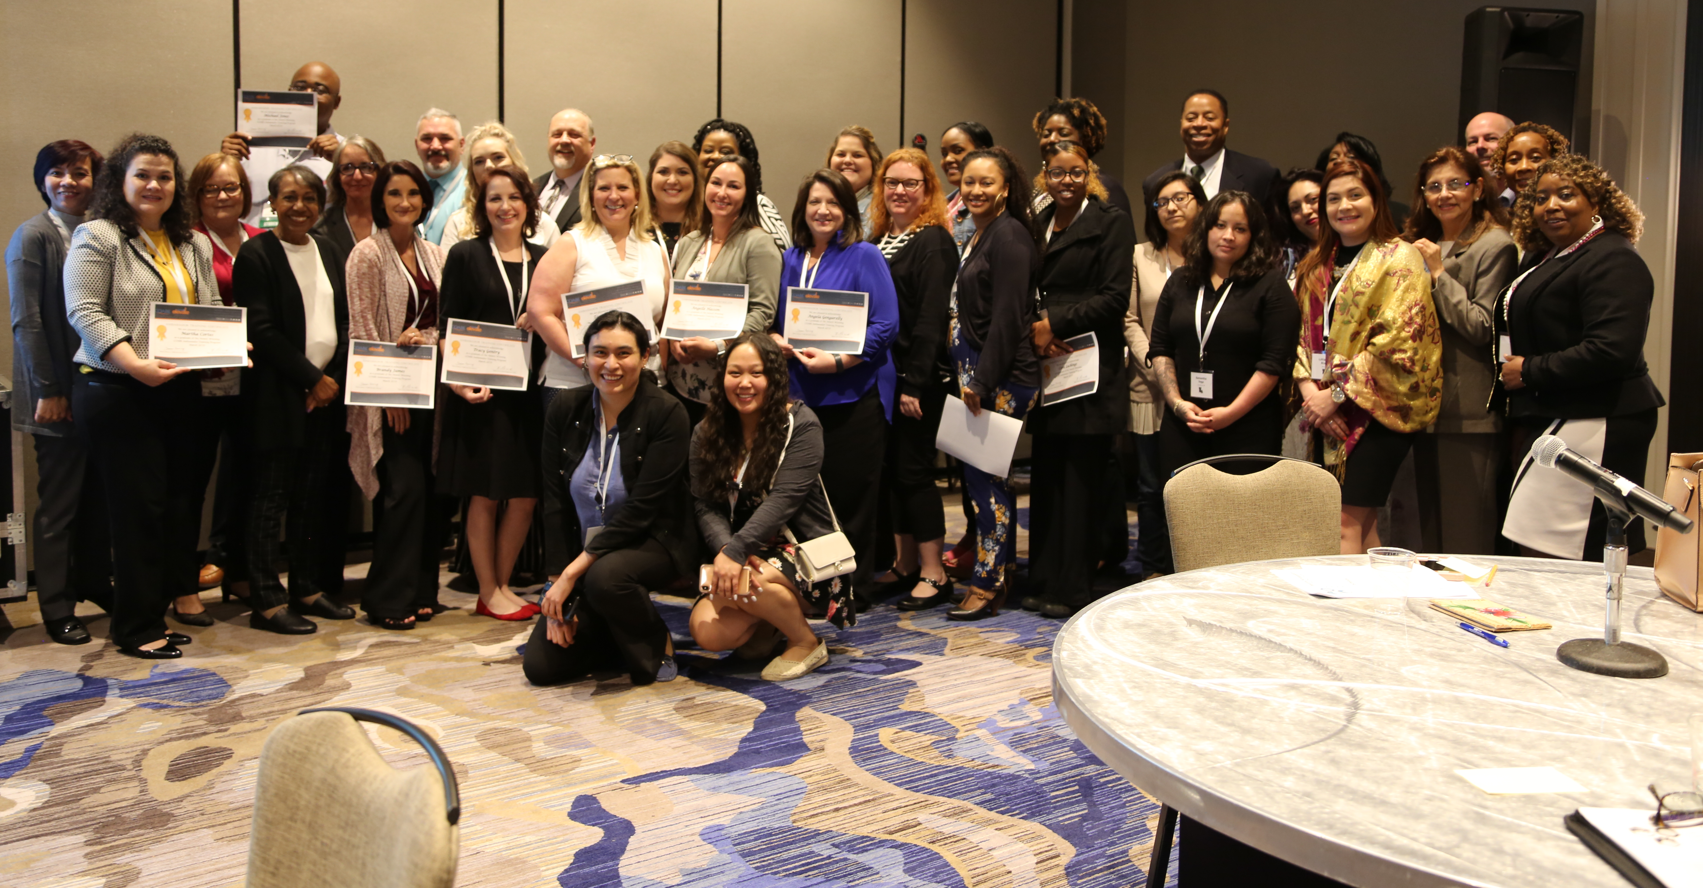
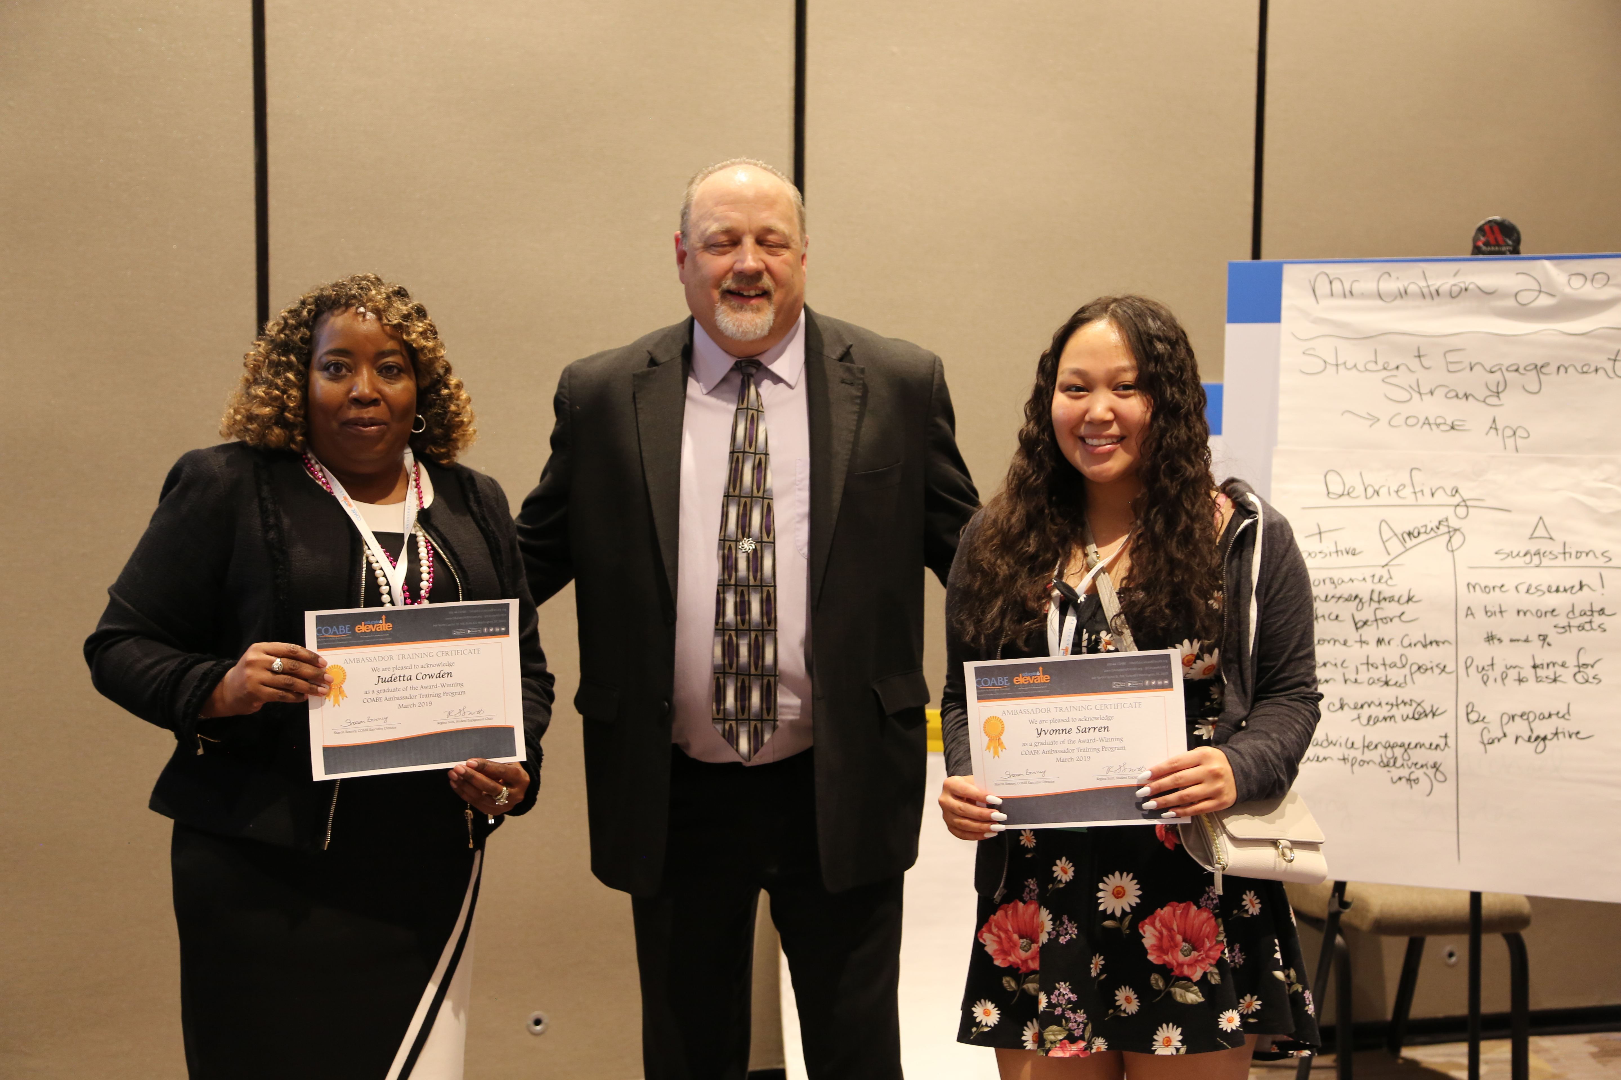
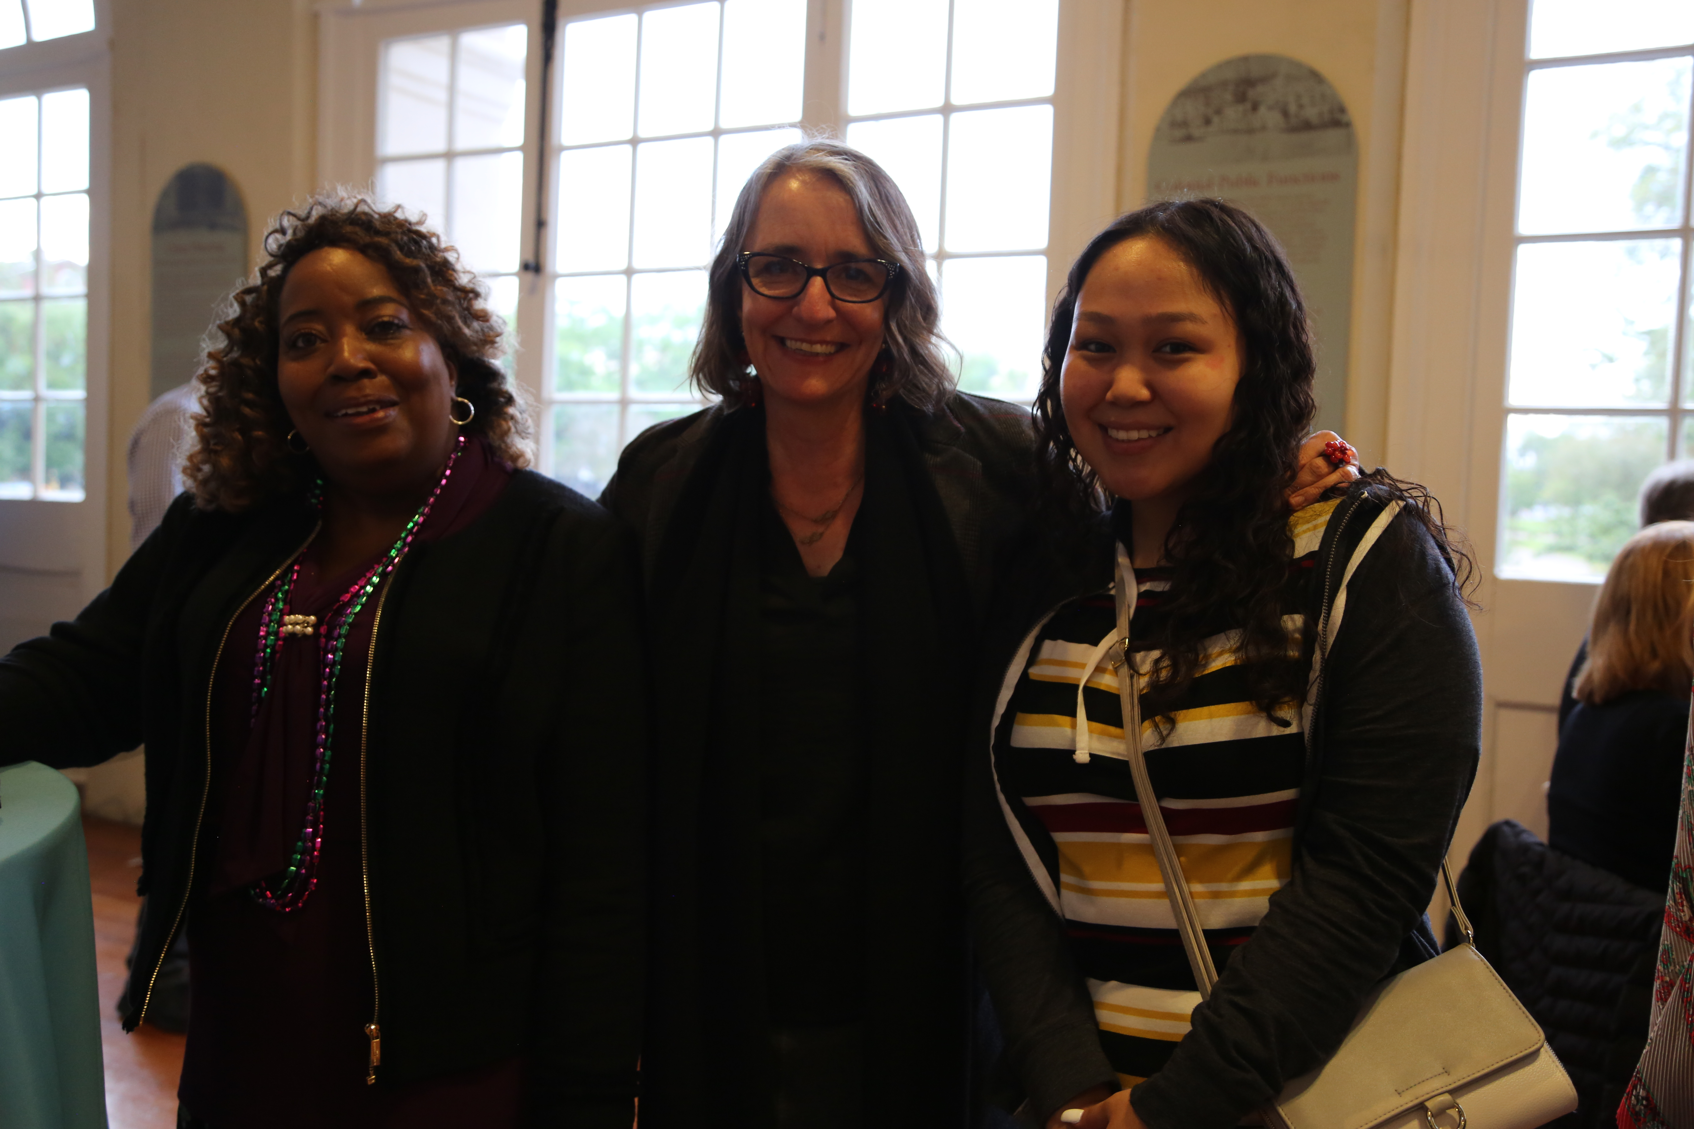
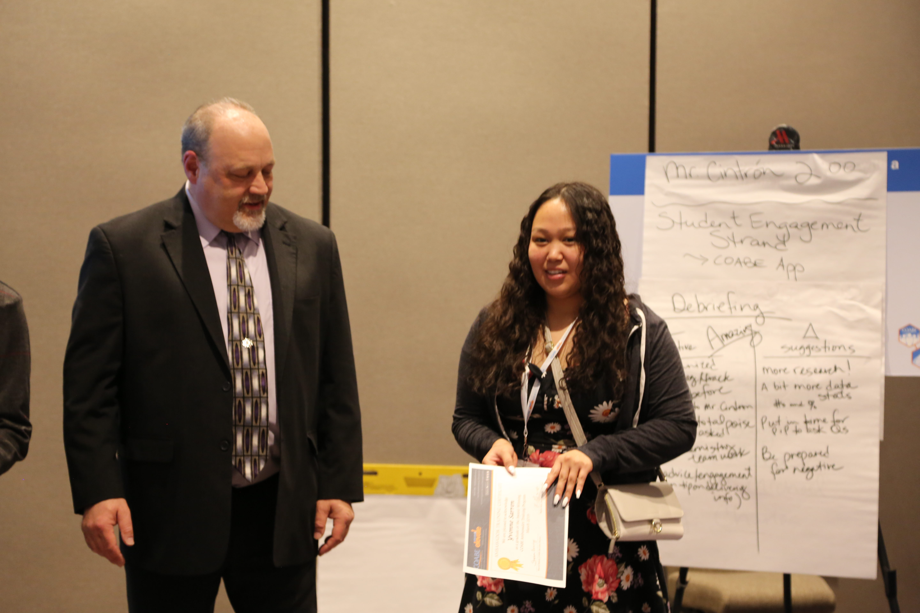
New Orleans

